Slide 1

Molecular epidemiology across pandemic response
What genomic data can support at different operational states
Justin Bahl
Notes:
Frame the lecture around decisions made during response, rather than around a sequence of analytic methods.

Slide 2
The public-health question changes throughout an outbreak
1
2
3
4
5
6
7
Preparedness
Anomaly
Establishment
Investigation
Expansion
Intervention
Monitor Adaptation and Risk
Define the baseline
Verify the event
Introductions or local spread?
Which cases belong together?
What process drives incidence?
Where can action change outcomes?
Has risk changed? What did we miss?
A jurisdiction may occupy several operational states at the same time.
Local circulation can coexist with new introductions, cluster investigations, and emerging variants.
Notes:
These are operational states rather than formal global pandemic phases.
The response changes when the dominant transmission process, available information, or intervention capacity changes.

Slide 3
The public-health question changes throughout an outbreak
These response states are a decision-centered organizing framework, not discrete epidemic phases. Several may operate simultaneously within a jurisdiction, recur over time, and use the same methods for different questions.
The relevant state depends on the operational decision, available evidence, dominant epidemic process, and intervention capacity, not simply time since emergence.
1
2
3
4
5
6
7
Preparedness
Anomaly
Establishment
Investigation
Expansion
Intervention
Change and learning
Define the baseline
Verify the event
Introductions or local spread?
Which cases belong together?
What process drives incidence?
Where can action change outcomes?
Has risk changed? What did we miss?
A jurisdiction may occupy several operational states at the same time.
Local circulation can coexist with new introductions, cluster investigations, and emerging variants.
Notes:
These are operational states rather than formal global pandemic phases.
The response changes when the dominant transmission process, available information, or intervention capacity changes.

Slide 4
A repeated decision frame for every response state
OPERATIONAL PROBLEM
What must public health decide now?
AVAILABLE EVIDENCE
What data plausibly exist at this point in the response?
GENOMIC CONTRIBUTION
Which inference becomes possible after adding sequence data?
DECISION CONSEQUENCE
What action could change because of the result?
FAILURE MODE
Which missing data or assumptions could reverse the conclusion?
Notes:
Use this frame explicitly at each transition. It prevents the lecture from becoming a catalogue of methods.

Slide 5
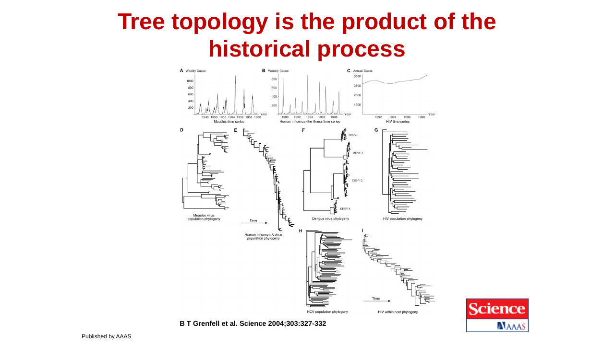

Slide 6
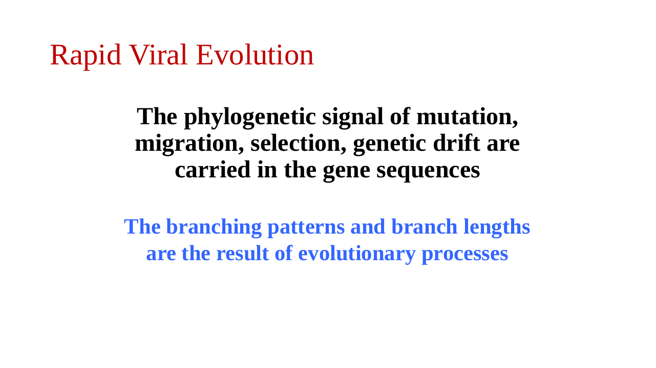

Slide 7
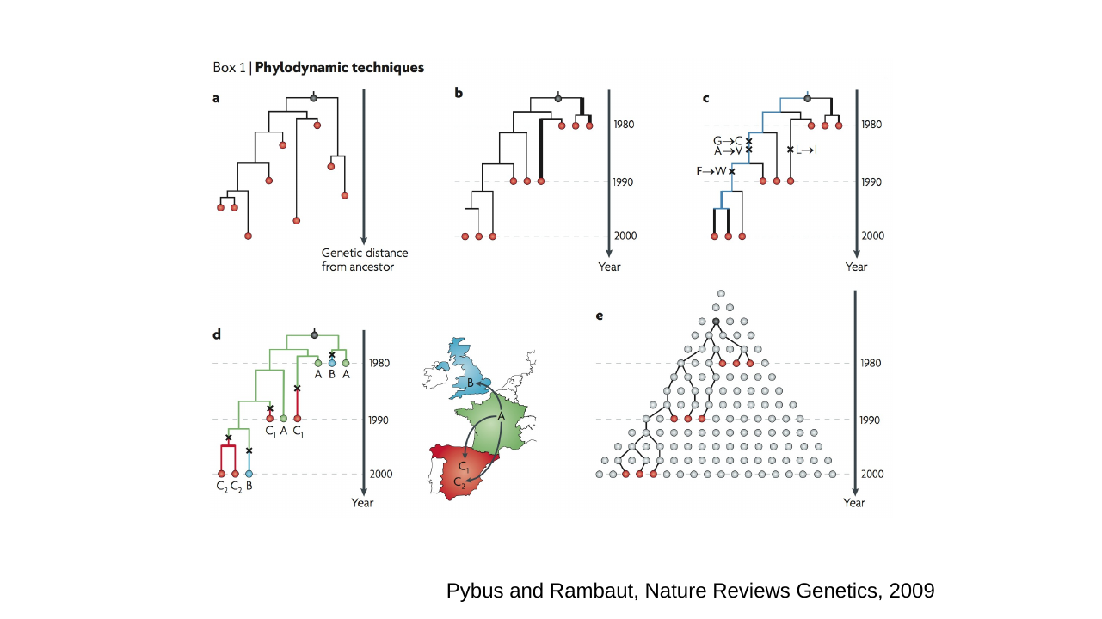

Slide 8
01
Preparedness and baseline surveillance
PUBLIC-HEALTH QUESTION
What does normal pathogen diversity and circulation look like?
MOLECULAR EPIDEMIOLOGY
Establish the reference population needed to recognize departures from expectation.
Operational states overlap across places and populations.

Slide 9
An anomaly depends on the surveillance baseline
OBSERVED BACKGROUND
NEW OBSERVATION
Biological departure or surveillance gap?
Observed diversity reflects biology and where surveillance looked.
Without a credible baseline, novelty is partly a property of sampling.
Notes:
Distinguish biological novelty from novelty created by sparse or geographically biased sampling.
Ask what additional sampling would make the event less surprising.

Slide 10
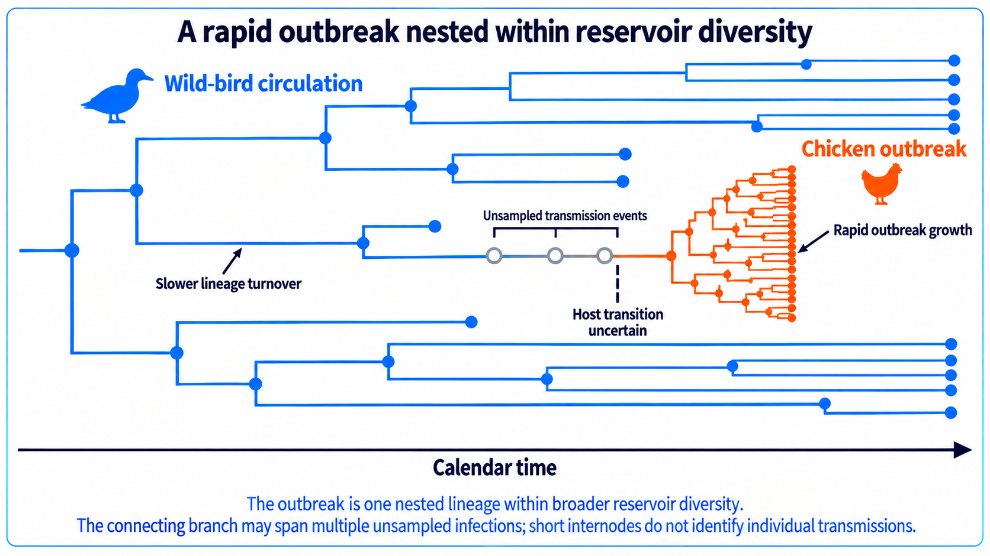
Spillover and transmission variation on a tree
Notes:
Use this as the organizing model for the rest of the lecture. Distinguish biological diversity from observed sequence diversity.
[Sources]
- McCrone JT, Lauring AS. Curr Opin Virol. 2018. https://doi.org/10.1016/j.coviro.2017.10.008
- WHO genomic surveillance strategy. https://www.who.int/initiatives/genomic-surveillance-strategy

Slide 11
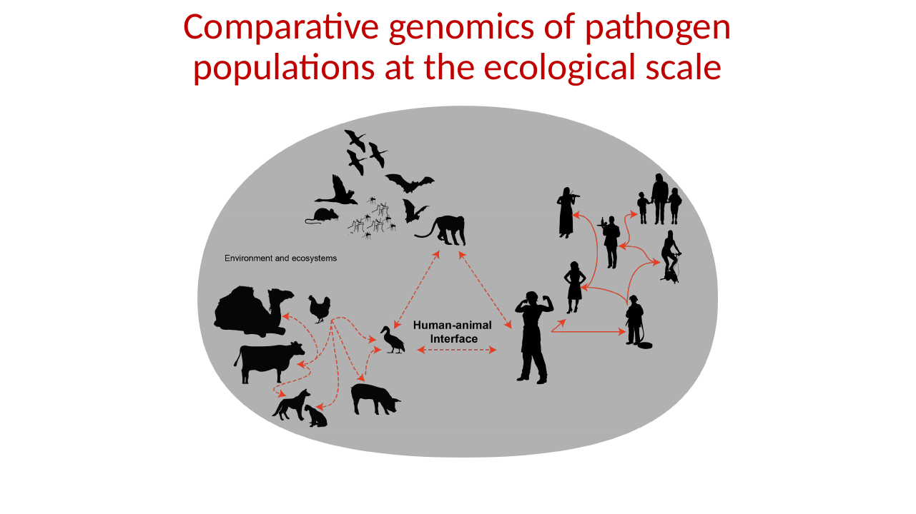

Slide 12
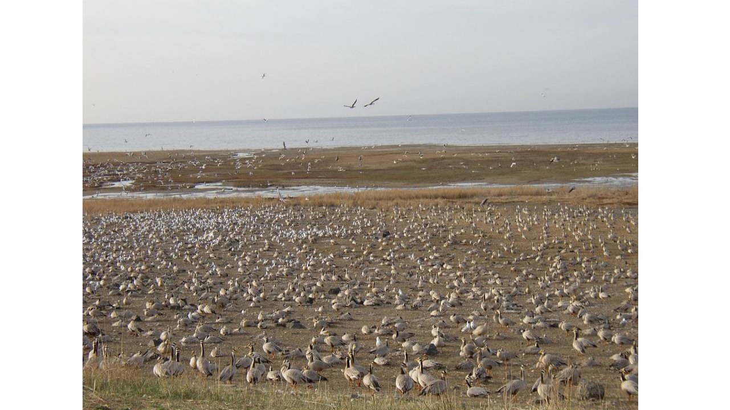

Slide 13
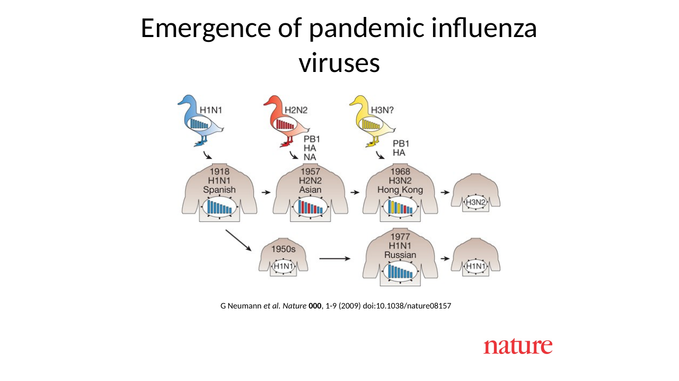

Slide 14
02
Detect and verify an anomalous event
PUBLIC-HEALTH QUESTION
Is this a genuine emergence event, and what exactly has emerged?
MOLECULAR EPIDEMIOLOGY
Identify the pathogen or lineage, validate the sequence, and place it within known diversity.
Operational states overlap across places and populations.

Slide 15
Three claims require different evidence
1
2
3
Sequence novelty
Phenotypic novelty
Epidemiological importance
A genome differs from the sampled reference population.
The change affects transmissibility, severity, immunity, diagnostics, or treatment.
The phenotype changes population risk or the expected value of an intervention.
A sequence can establish the first claim. The next two require epidemiologic and experimental evidence.
Notes:
Do not infer phenotype from genetic difference alone unless a validated genotype to phenotype relationship exists.
Do not infer population importance from phenotype without considering prevalence, exposure, and intervention context.

Slide 16
Timeline
Early reports of of a respiratory illness in La Gloria Mexico
April 15 and April 17, 2009, novel swine-origin influenza A (H1N1) virus (S-OIV) was identified in two epidemiologically unlinked patients in the United States
Related cases and viruses were identified in Mexico, Canada

Slide 17
Timeline
Spread across the globe in weeks
Global network of scientists was made aware of the new threat April 23/24th
First sequences of the novel influenza virus was available April 24th

Slide 18
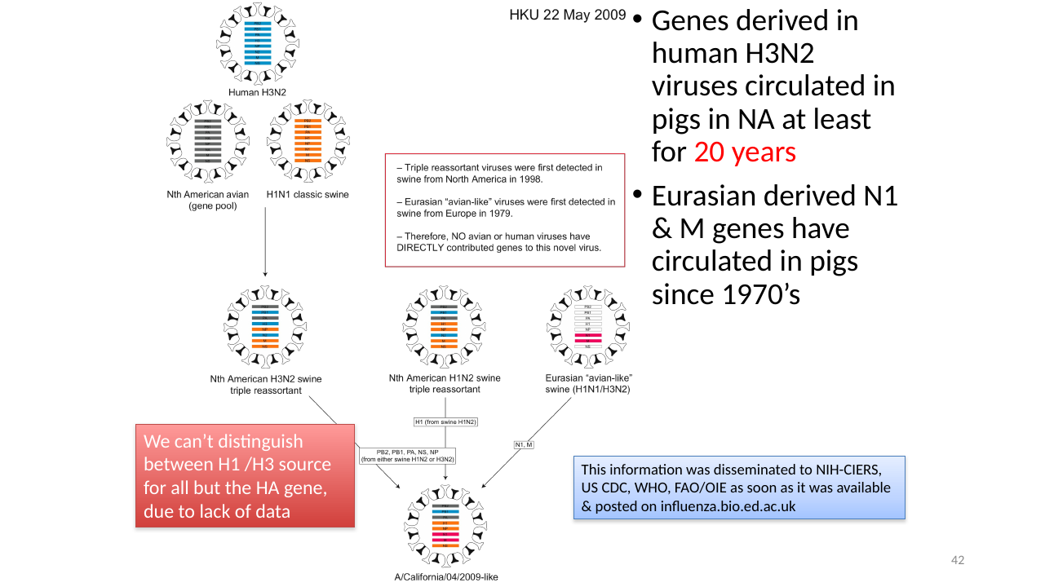

Slide 19
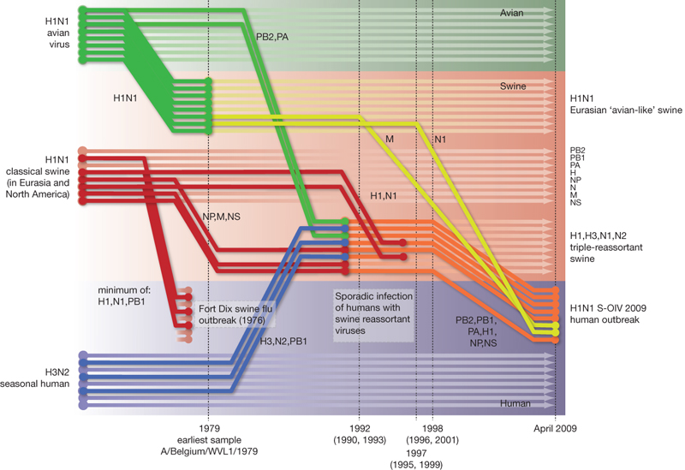

Reconstruction of the sequence of reassortment events leading up to the emergence of S-OIV.
GJD Smith et al. Nature 459, 1122-1125 (2009) doi:10.1038/nature08182

Slide 20
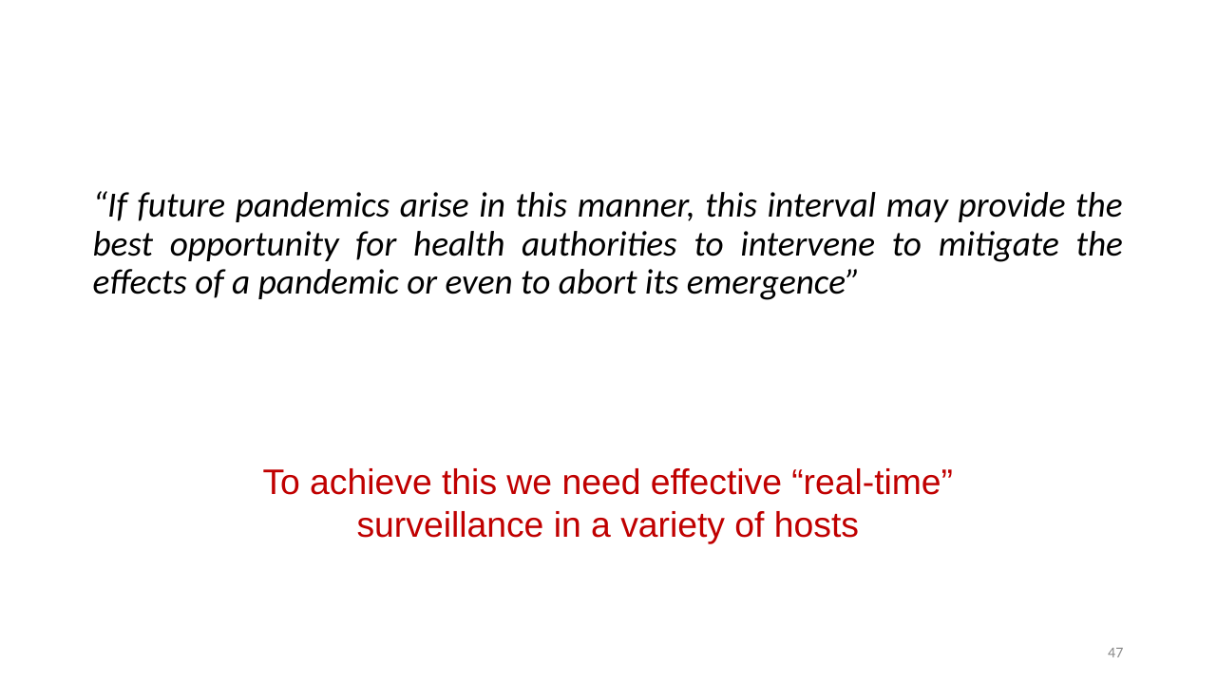

Slide 21
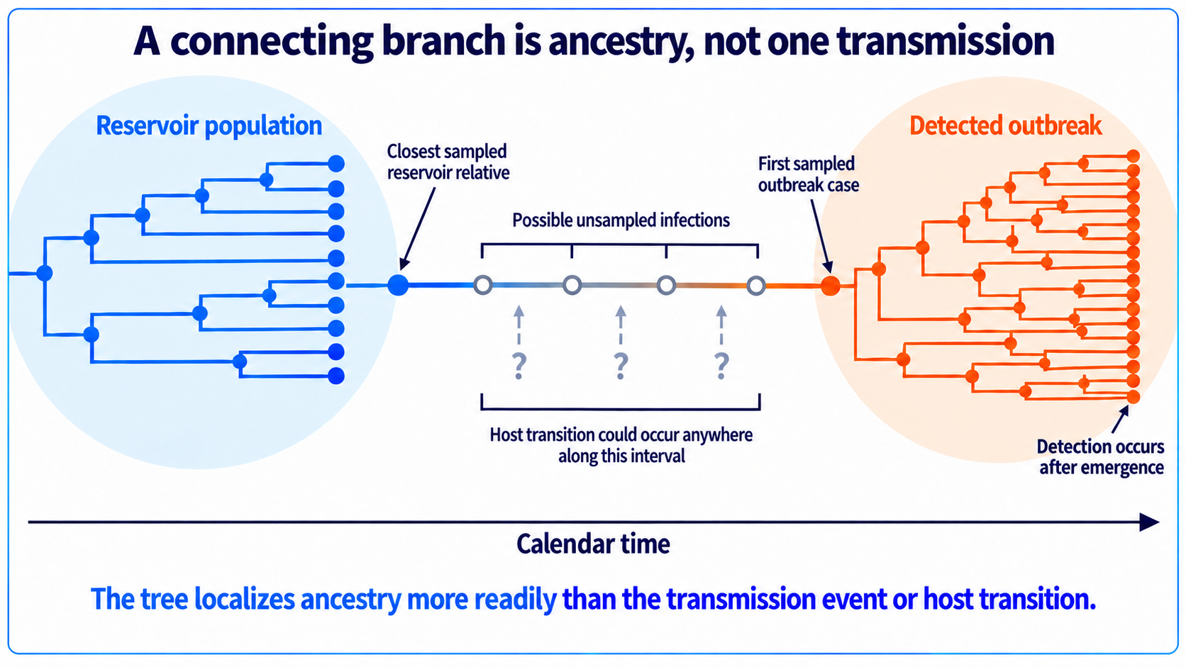

Slide 22
03
Prevent establishment
PUBLIC-HEALTH QUESTION
How much of current incidence reflects new introductions versus local transmission, and is local transmission becoming self-sustaining?
MOLECULAR EPIDEMIOLOGY
Compare local genomes with external diversity and estimate what differentiation is plausible at the observed timescale.
Operational states overlap across places and populations.

Slide 23
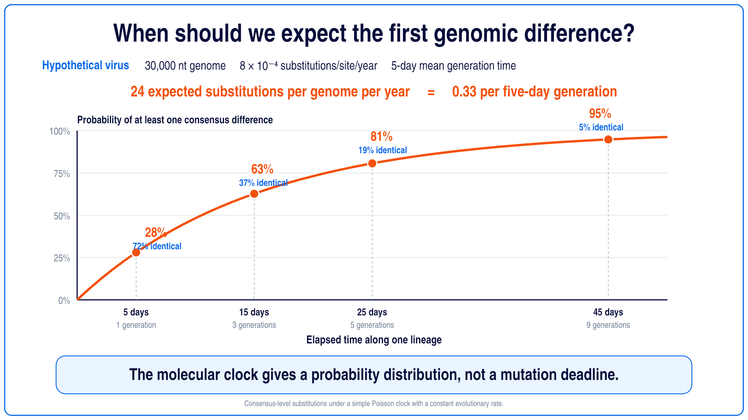
Notes:
Use the probability curve to establish why identical genomes remain common early in transmission.

Slide 24
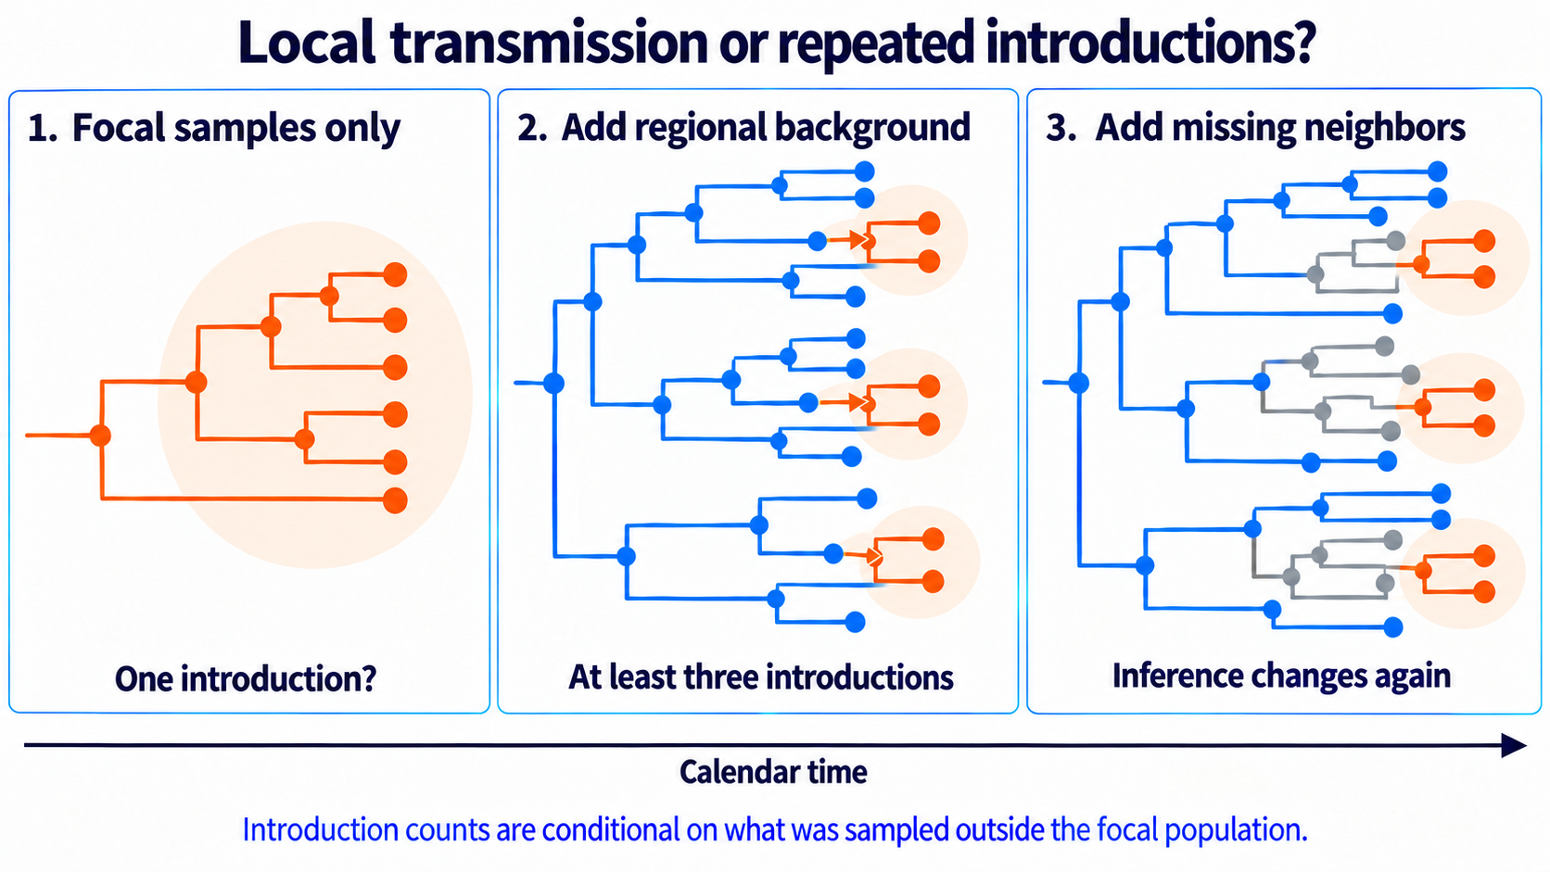

Slide 25
04
Investigate cases, contacts, and clusters
PUBLIC-HEALTH QUESTION
Which cases plausibly belong to the same source/ancestry?
MOLECULAR EPIDEMIOLOGY
Exclude incompatible links and identify groups consistent with recent shared ancestry.
Operational states overlap across places and populations.

Slide 26
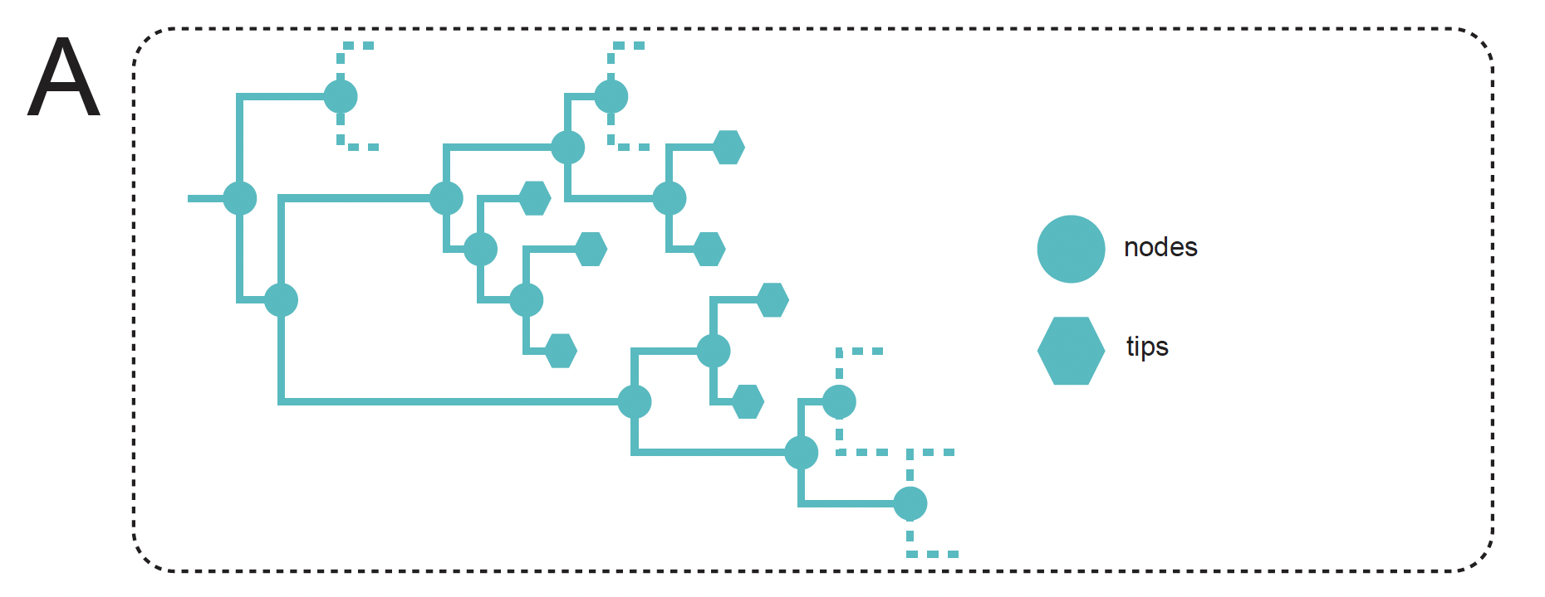

Methodology for Extracting Locally Circulating Clusters
Bioinformatic tool: Clusterfinder
Notes:
Imagine you prepared your dataset
placing focal-area sequences in the context of an appropriate background

Slide 27
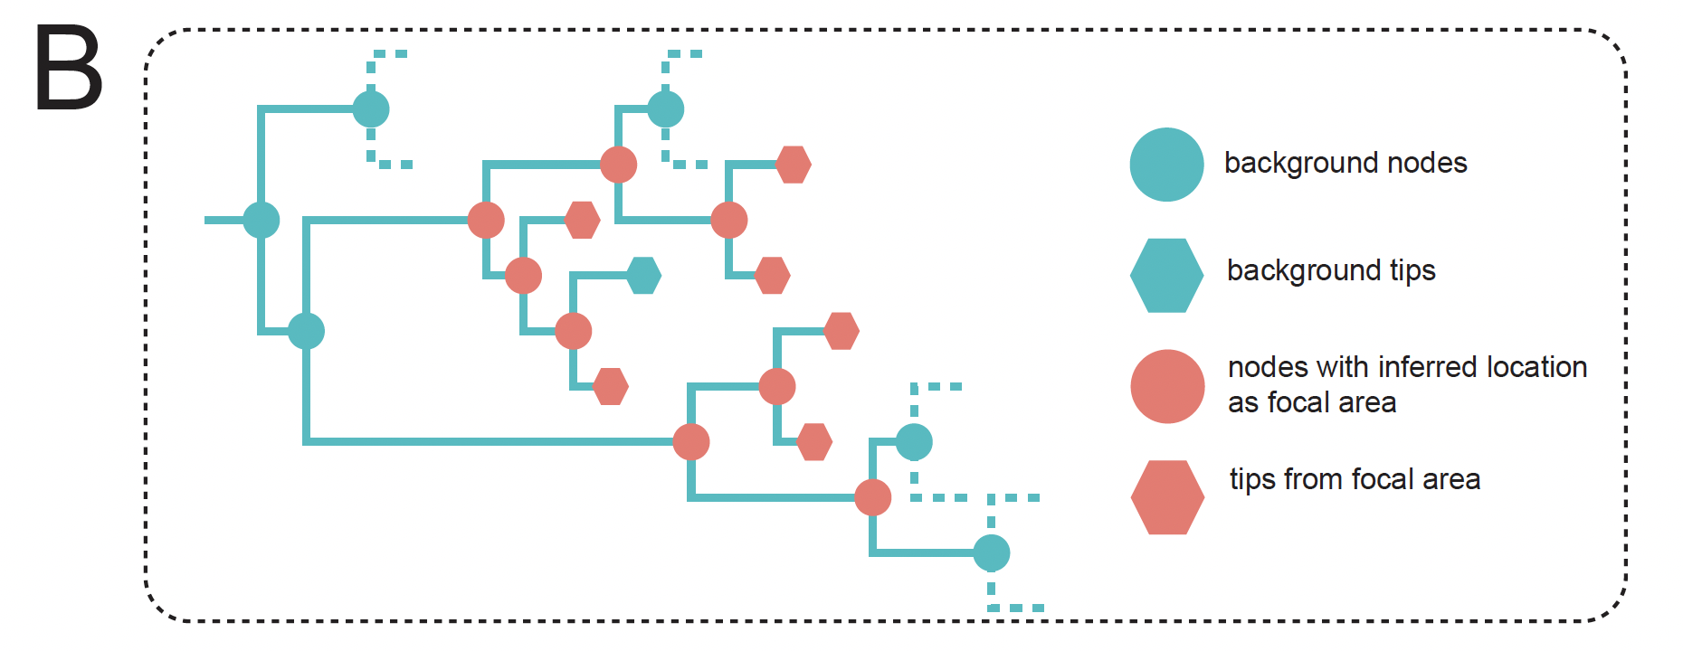
Methodology for Extracting Locally Circulating Clusters
Bioinformatic tool: Clusterfinder
Notes:
We can reconstruct the ancestral locations of the virus as Houston and non-houston

Slide 28
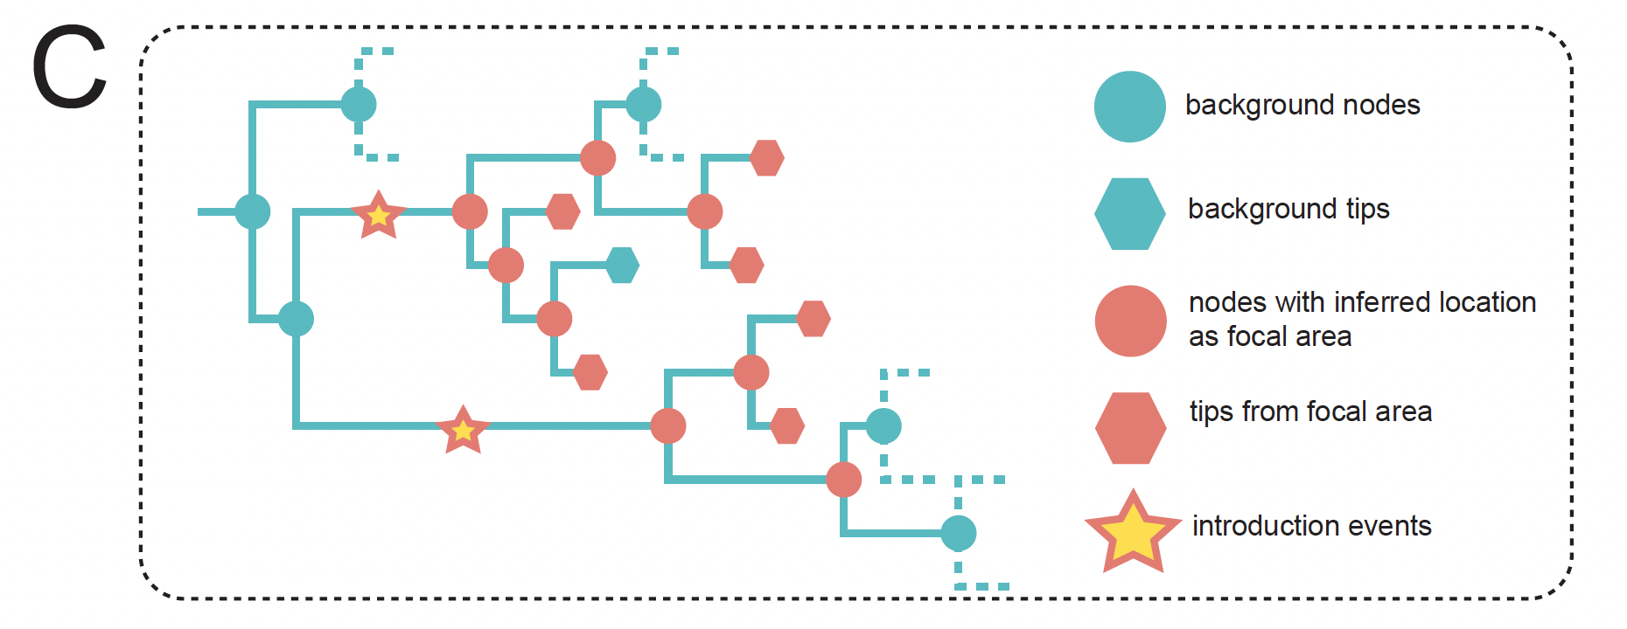
Methodology for Extracting Locally Circulating Clusters
Bioinformatic tool: Clusterfinder
Notes:
We identified introduction events on branches connecting ‘non-Houston’ nodes (categorized as either 'Domestic' or 'International') to ‘Houston’ nodes
The introduction time was defined as the midpoint of these branches.

Slide 29
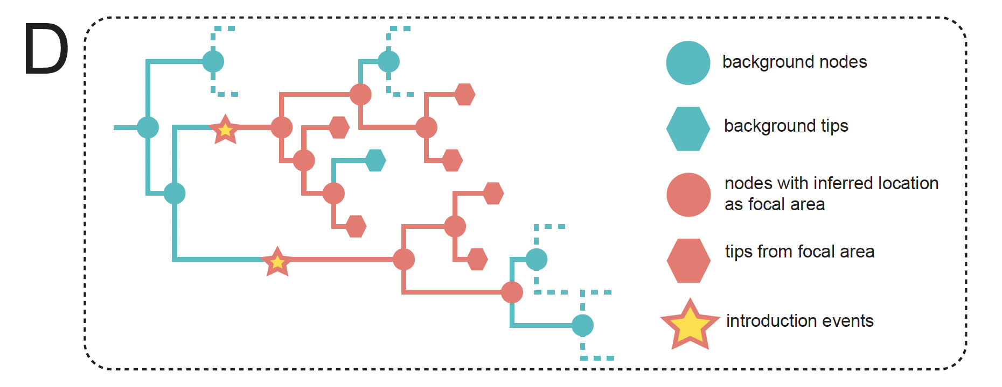
Methodology for Extracting Locally Circulating Clusters
Bioinformatic tool: Clusterfinder
Notes:
Starting from each introduction event
we apply a depth-first search to identify and encompass all downstream nodes or tips assigned to Houston, grouping them into a circulating cluster.

Slide 30
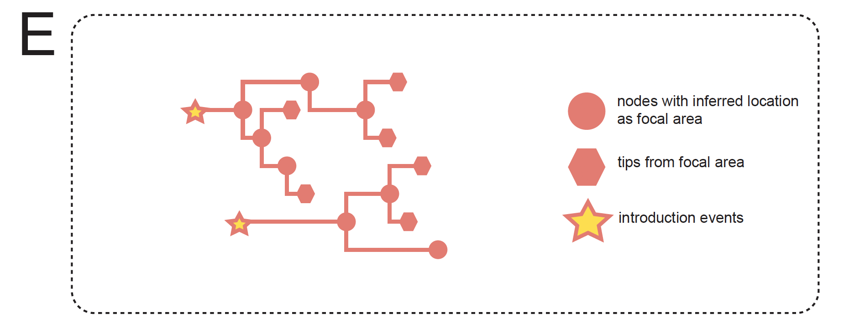
Methodology for Extracting Locally Circulating Clusters
Bioinformatic tool: Clusterfinder
Notes:
We also refine the cluster by pruning branches

Slide 31
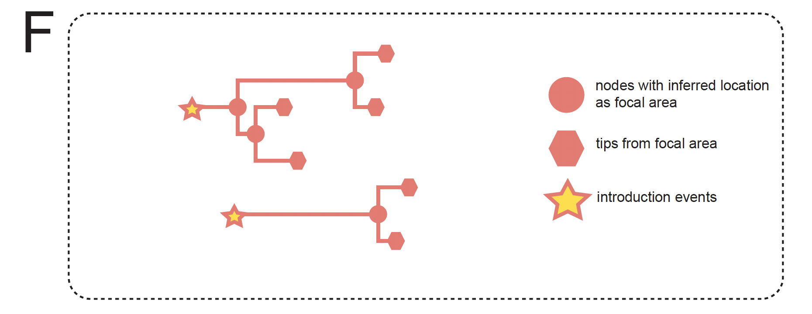
Methodology for Extracting Locally Circulating Clusters
Bioinformatic tool: Clusterfinder
Notes:
And finally, we obtain these clusters.
The algorithm and script are part of our bioinformatics tool, ClusterFinder, which supports the analysis presented in this chapter.

Slide 32
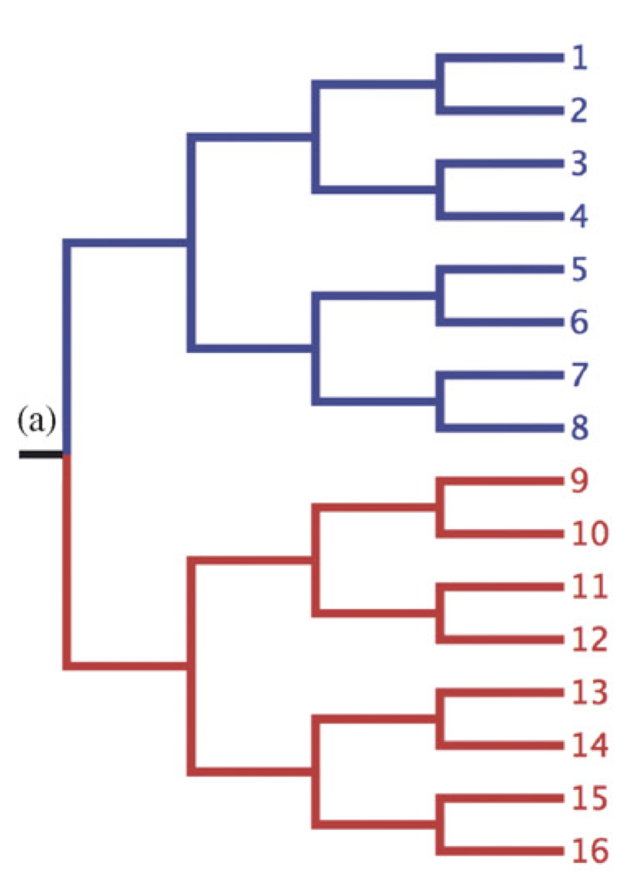
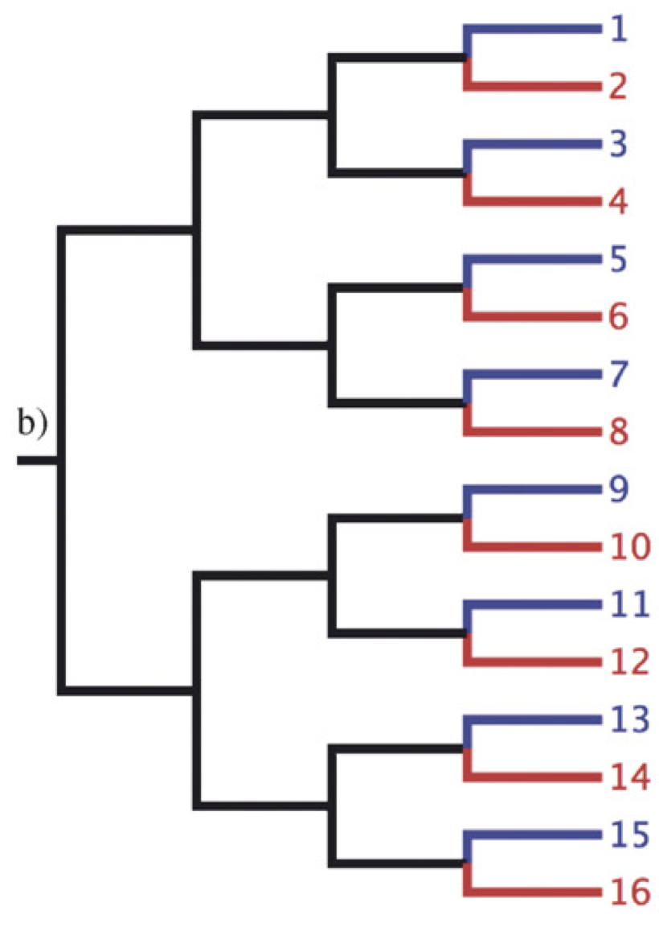
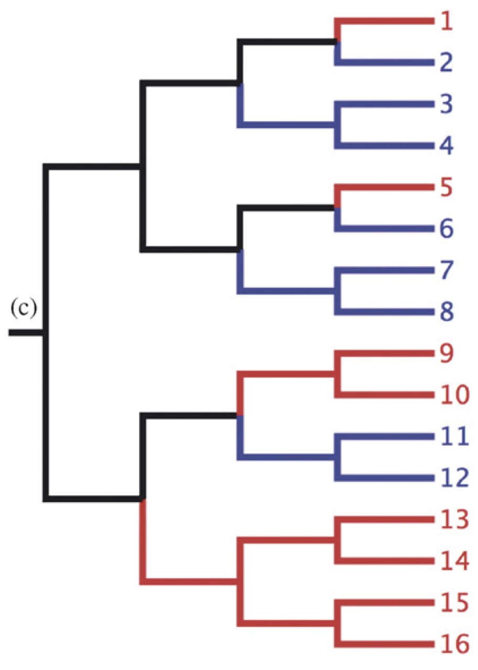
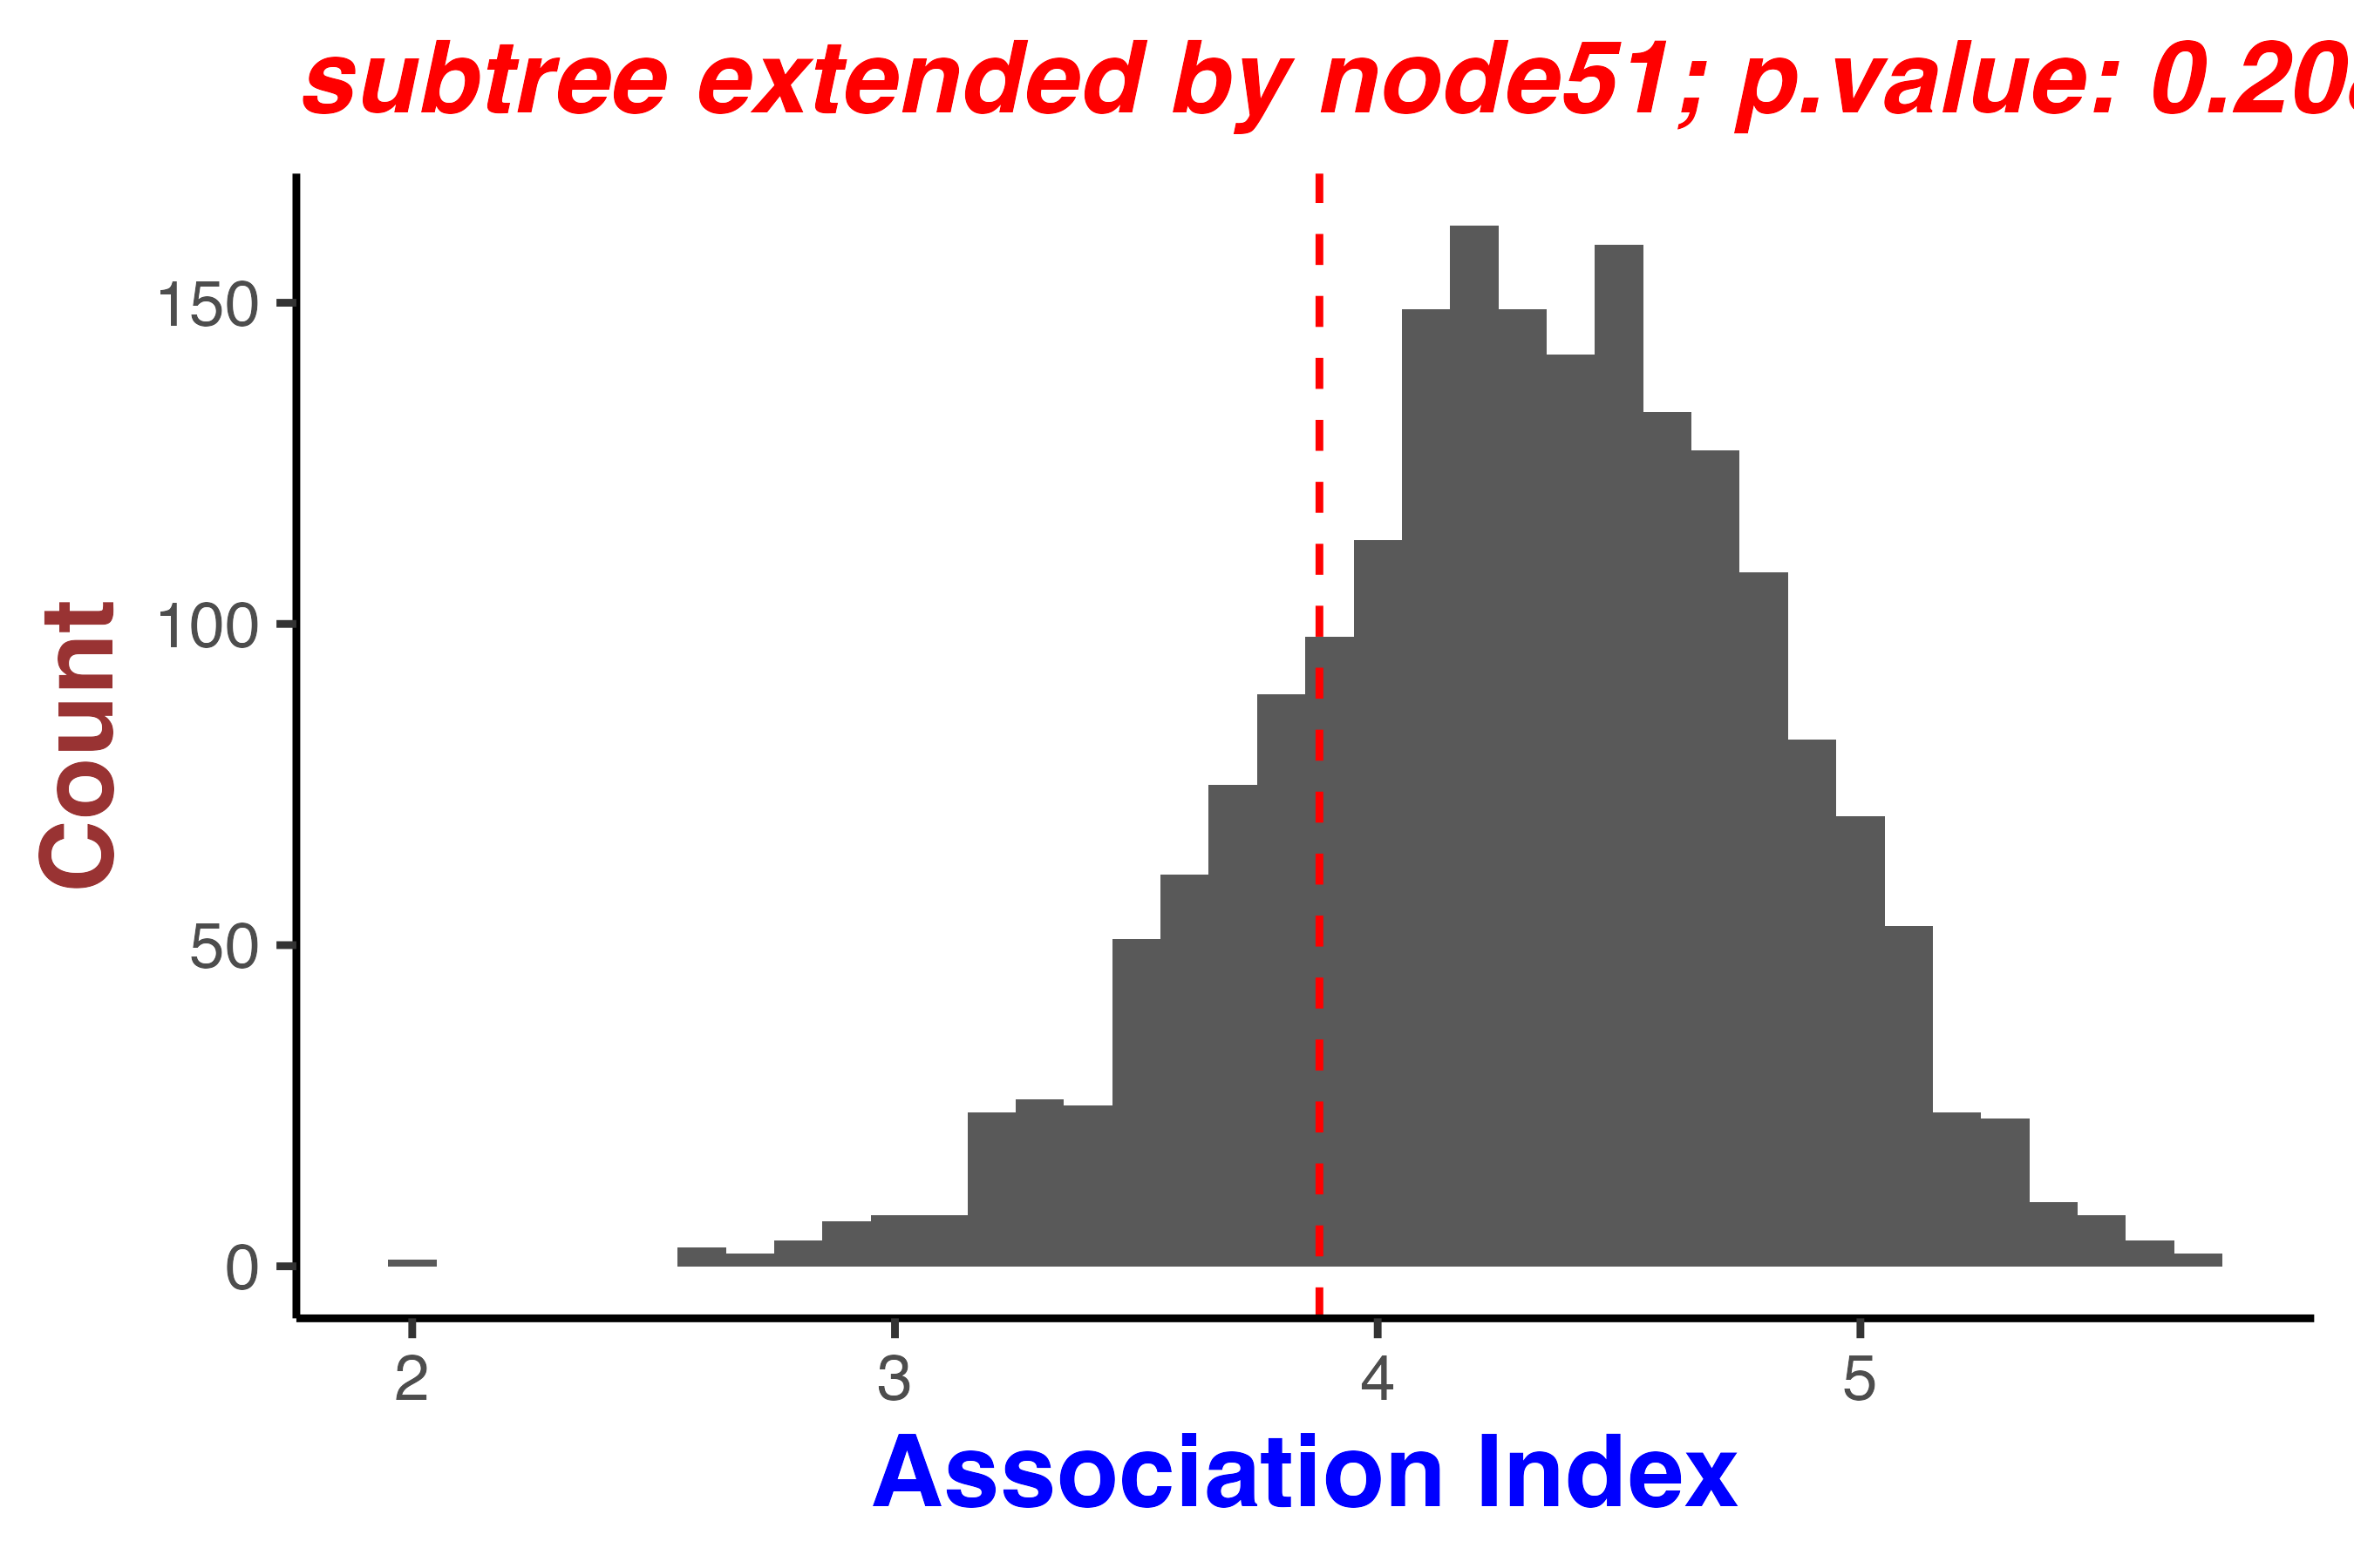
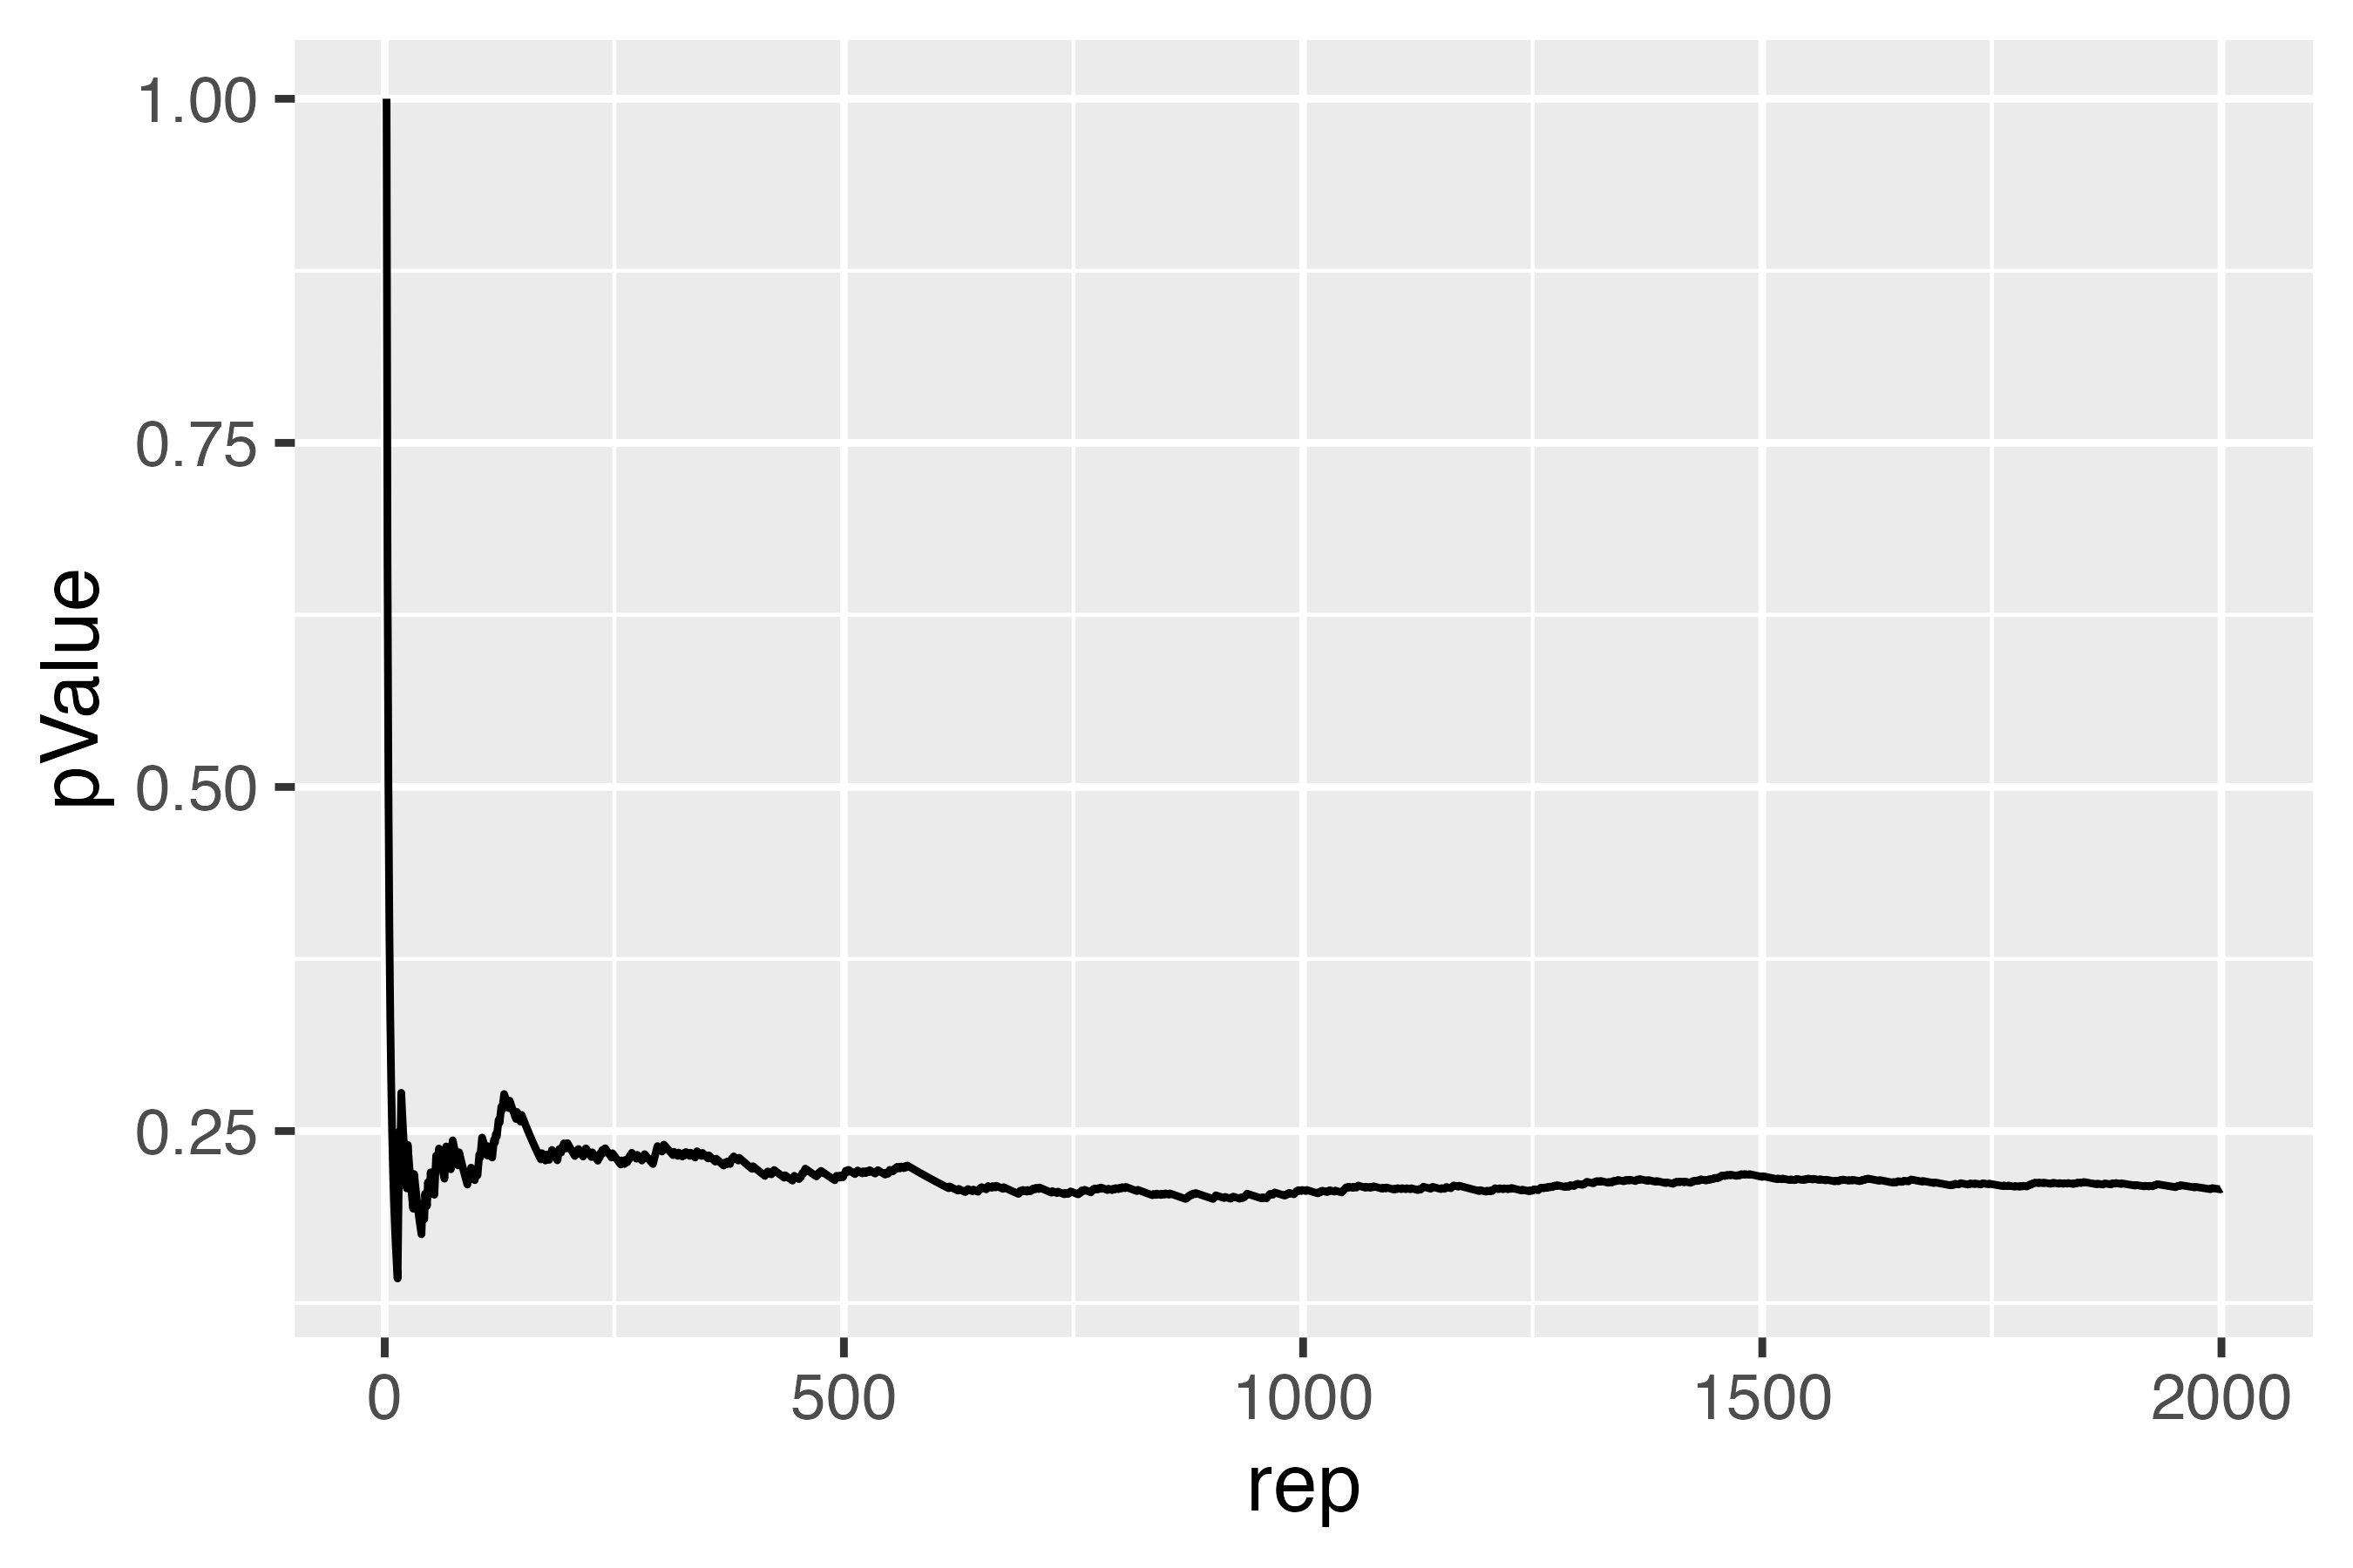
Phylogeny-trait association test
Strong association
Maximally interspersed
?Intermediate situation
Bioinformatic tool: TTAT
Notes:
Numerous studies in genomic epidemiology explored the relationship between virus phylogenies and viral traits.
For example, if the trait represents geographic location, a strong correlation indicate limited lineage dispersal or migration, while a weak correlation would suggest high gene flow.
For a lot of time we can’t easily tell if there are a strong association.
Phylogeny-trait association test could help.
Our TTAT package implements two commonly used statistics—Association Index (AI) and Parsimony Score (PS)—to quantify the strength of phylogeny-trait correlation.
By randomizing trait assignments at the tips, we generate a null distribution, allowing us to assess statistical significance.
the p-value stabilizes as the size of the null distribution increases.

Slide 33
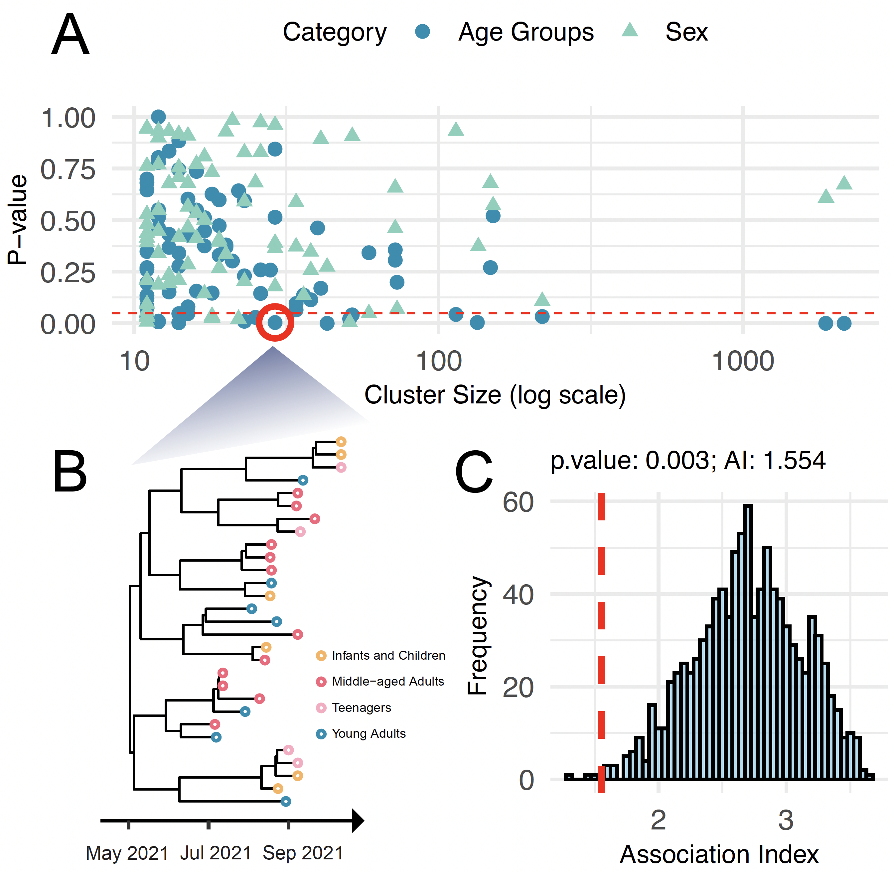
Local clusters showed phylogenetic structure associated with age.
Notes:
We selected 82 clusters, each containing more than 10 isolates, for further analysis of local dispersal. In total, these separate clusters included 6,455 sequences from the Greater Houston area
We investigated the correlations between phylogenetic structures and demographic traits, specifically age and sex, to better understand how these factors influence transmission dynamics
Age groups were categorized as follows: infants and children (0–12 years), teenagers (13–18 years), young adults (19–35 years), middle-aged adults (36–55 years), and seniors (56 years and older).
For each locally circulating cluster (Figure 3B), we did the phylogeny-trait association test
We found viral transmission is more constrained within age groups than within sex groups

Slide 34
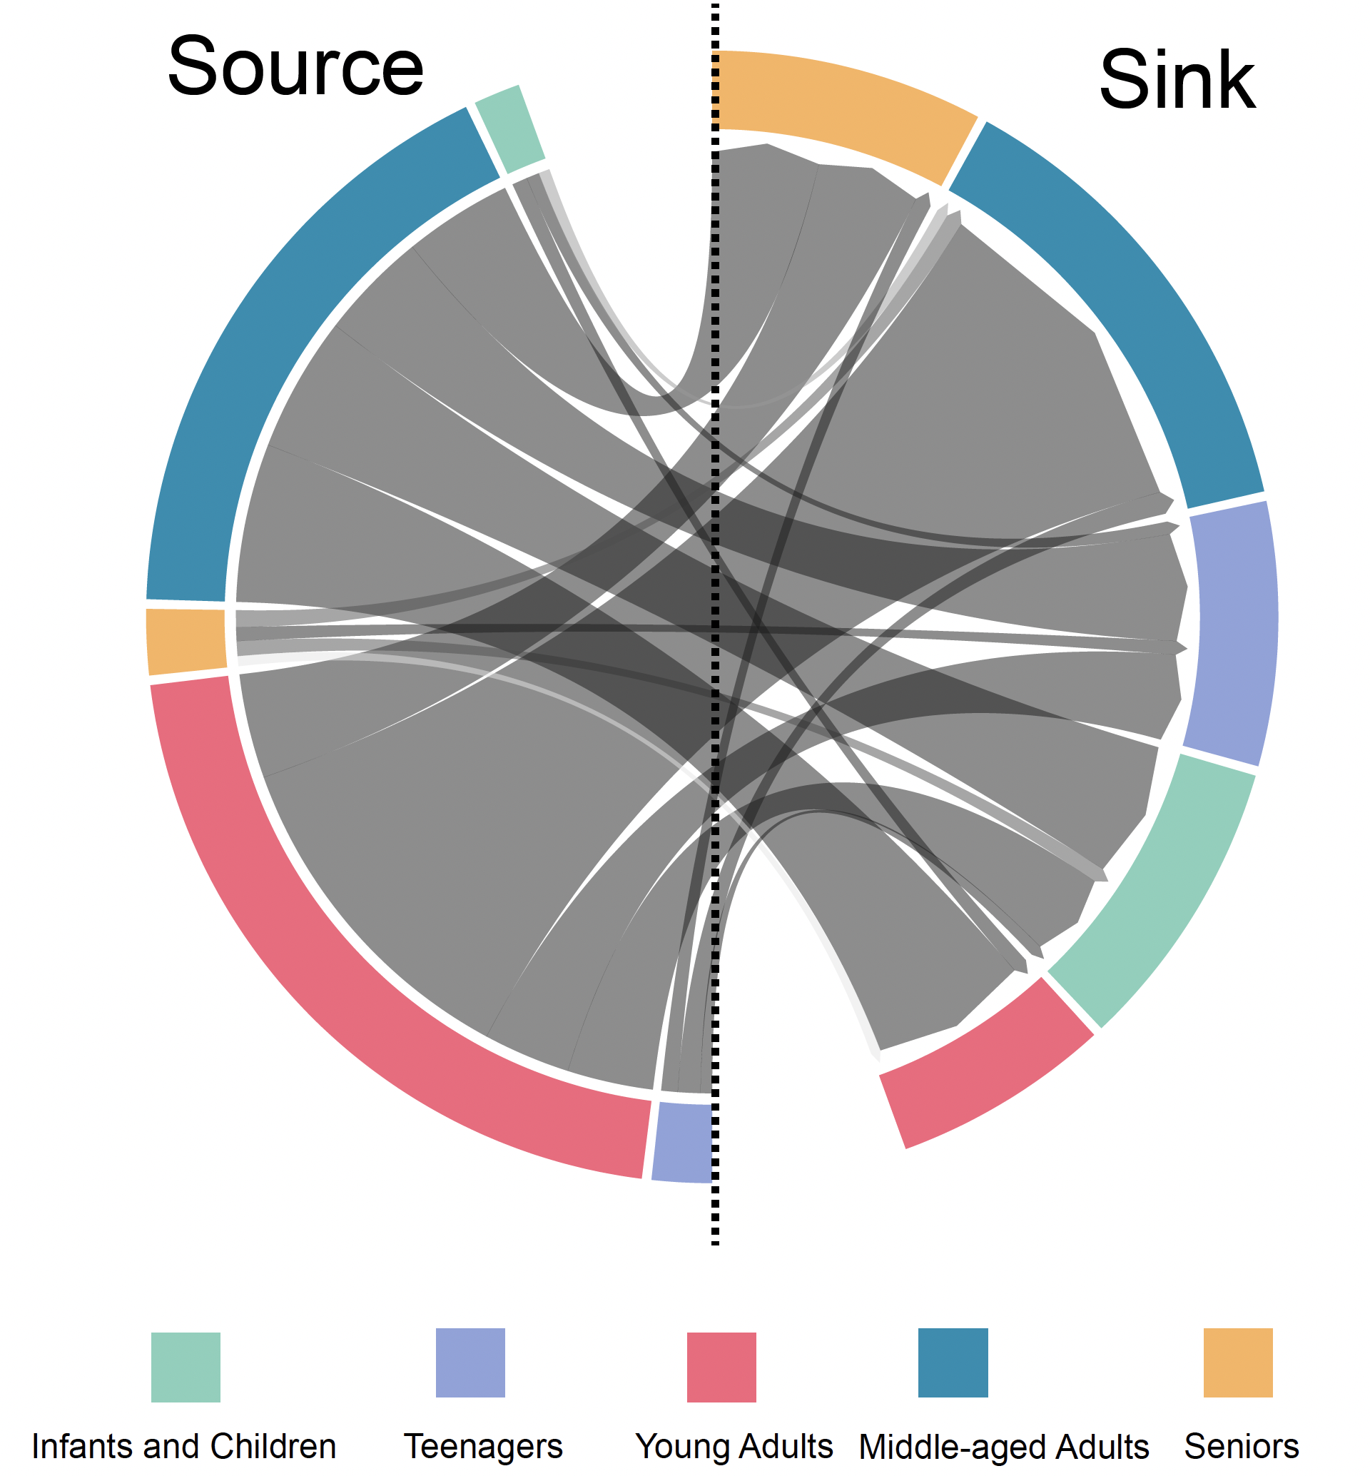
Analysis of locally circulating clusters revealed age-structured transmission dynamics
Notes:
We further quantified the transition rate between age groups and infected adults (ages 19-35) were a significant source for other age groups

Slide 35
05
Characterize an expanding outbreak
PUBLIC-HEALTH QUESTION
What process now drives incidence across the population?
MOLECULAR EPIDEMIOLOGY
Estimate introductions, local persistence, spatial spread, growth, and heterogeneity under an explicit sampling model.
Operational states overlap across places and populations.

Slide 36
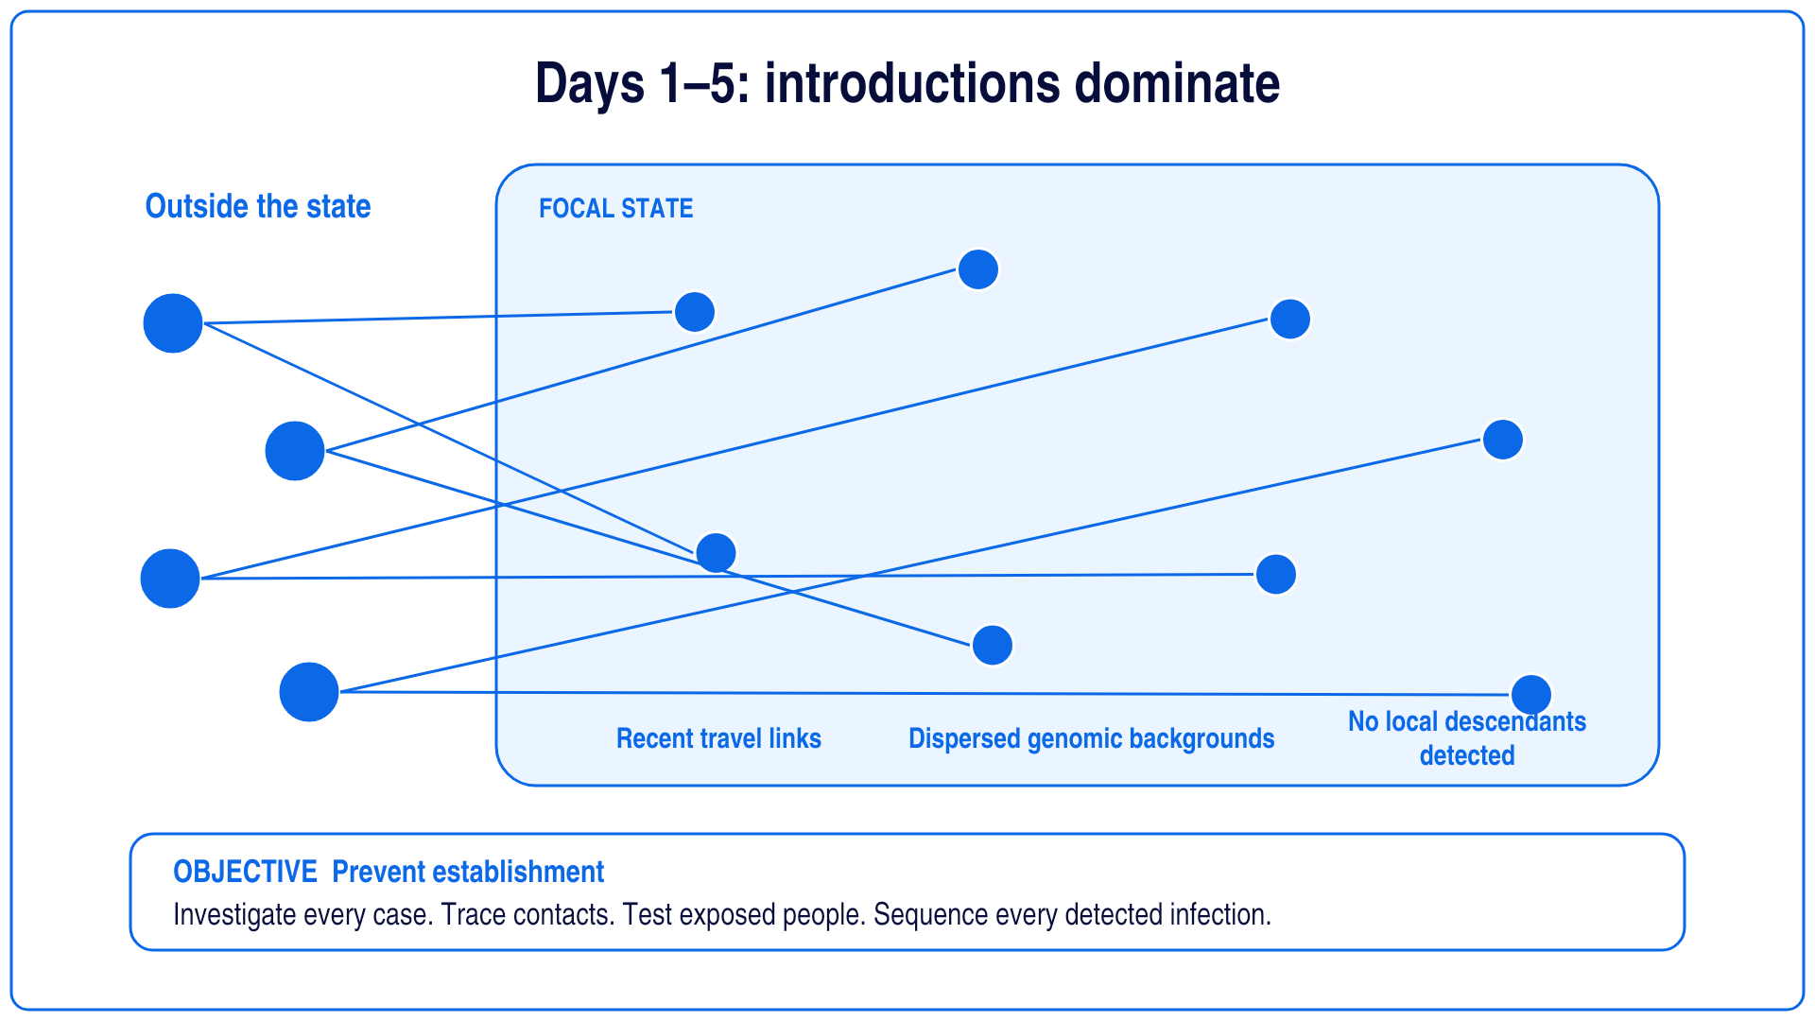

Slide 37
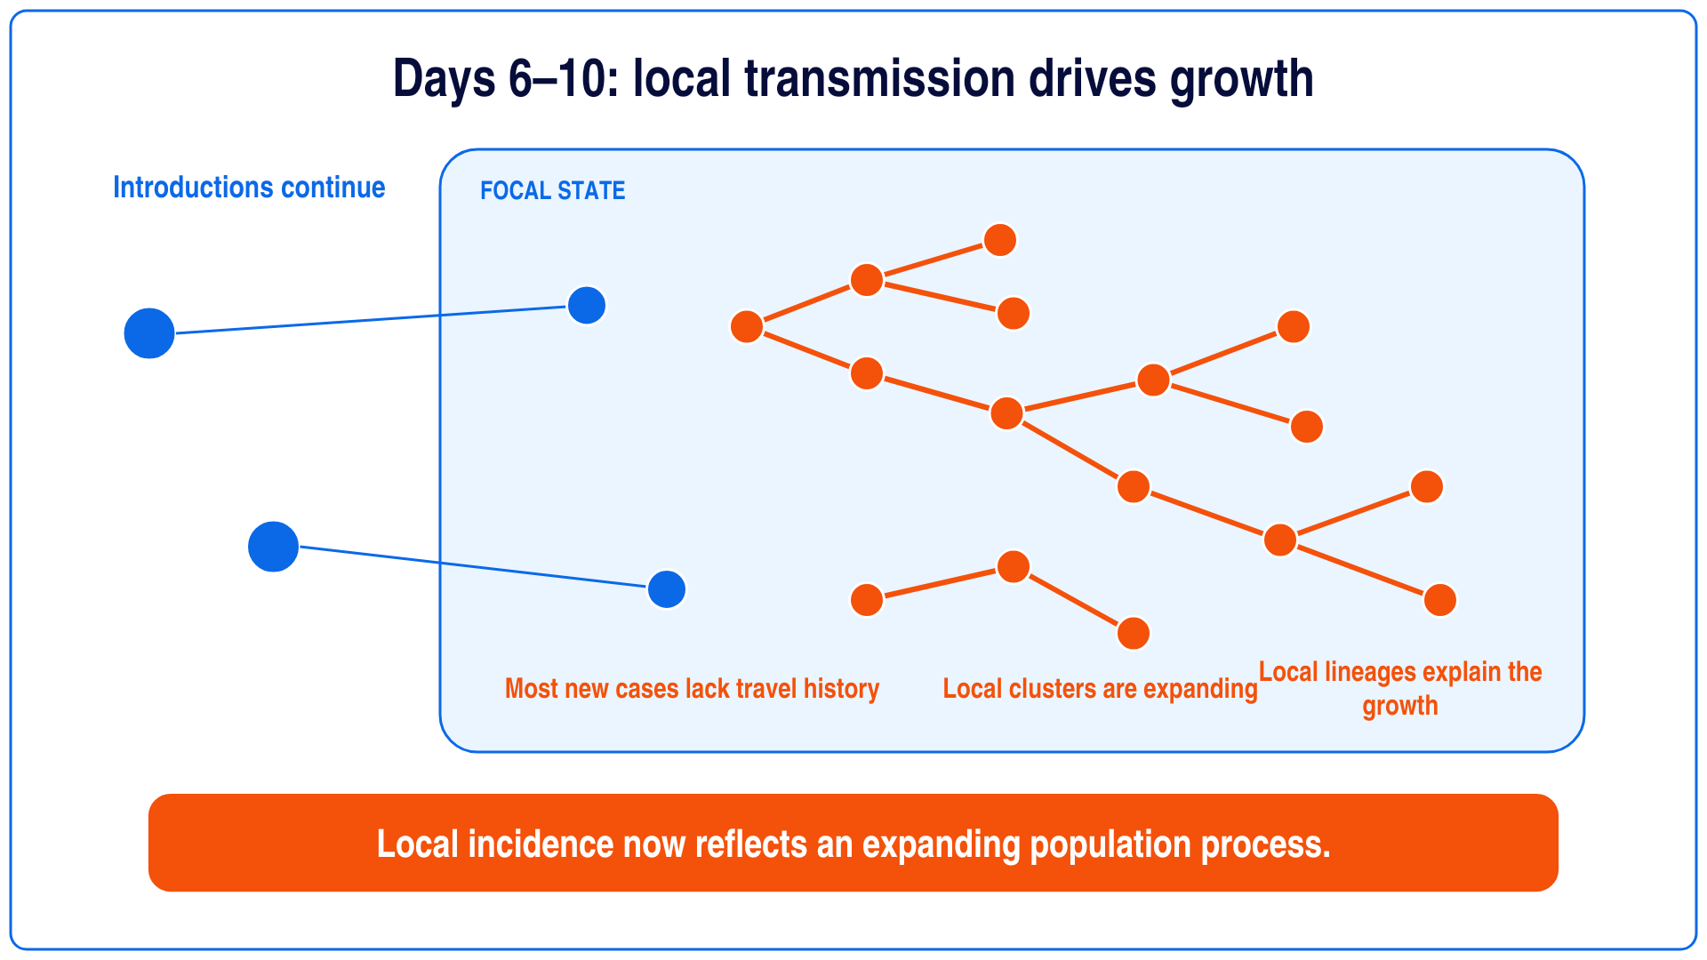

Slide 38

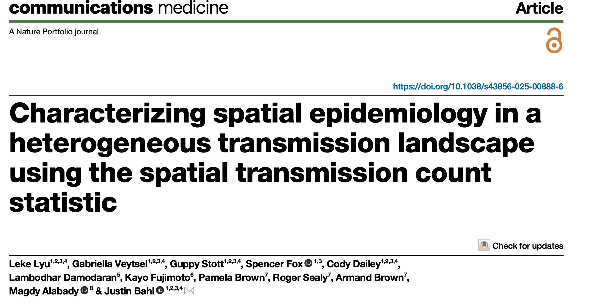

Slide 39
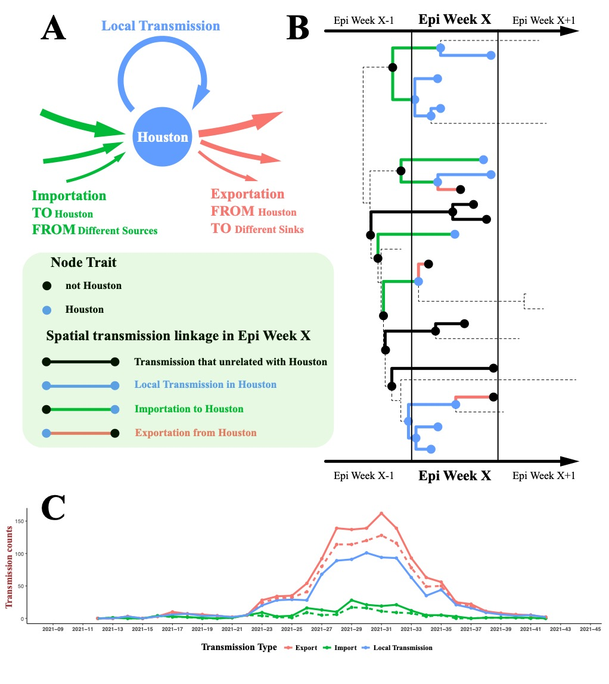
SARS-CoV-2
Are viruses circulating locally or being imported from surrounding regions?
Newly sequenced data released weekly
Large-scale and widespread sampling
Are disease dynamics uniform across Texas or is there a difference between urban and rural regions
Notes:
Figure 1. Houston-related spatial transmission linkages A. Houston-related transmission could be classified into three categories: importation, local transmission, and exportation. Importation could have multiple sources, and exportation could have multiple sinks. B. In epi-week X, the conceptual framework shows a total of 18 cases of Houston-related spatial transmission linkages: 6 counts of importation, 9 counts of local transmission, and 3 counts of exportation. C. This 'count' summary could be extended into a time series analysis to investigate the epidemic trends in Houston. The dashed pink line represents exportations to the context (areas outside of Texas), while the dashed green line represents importations from the context.

Slide 40
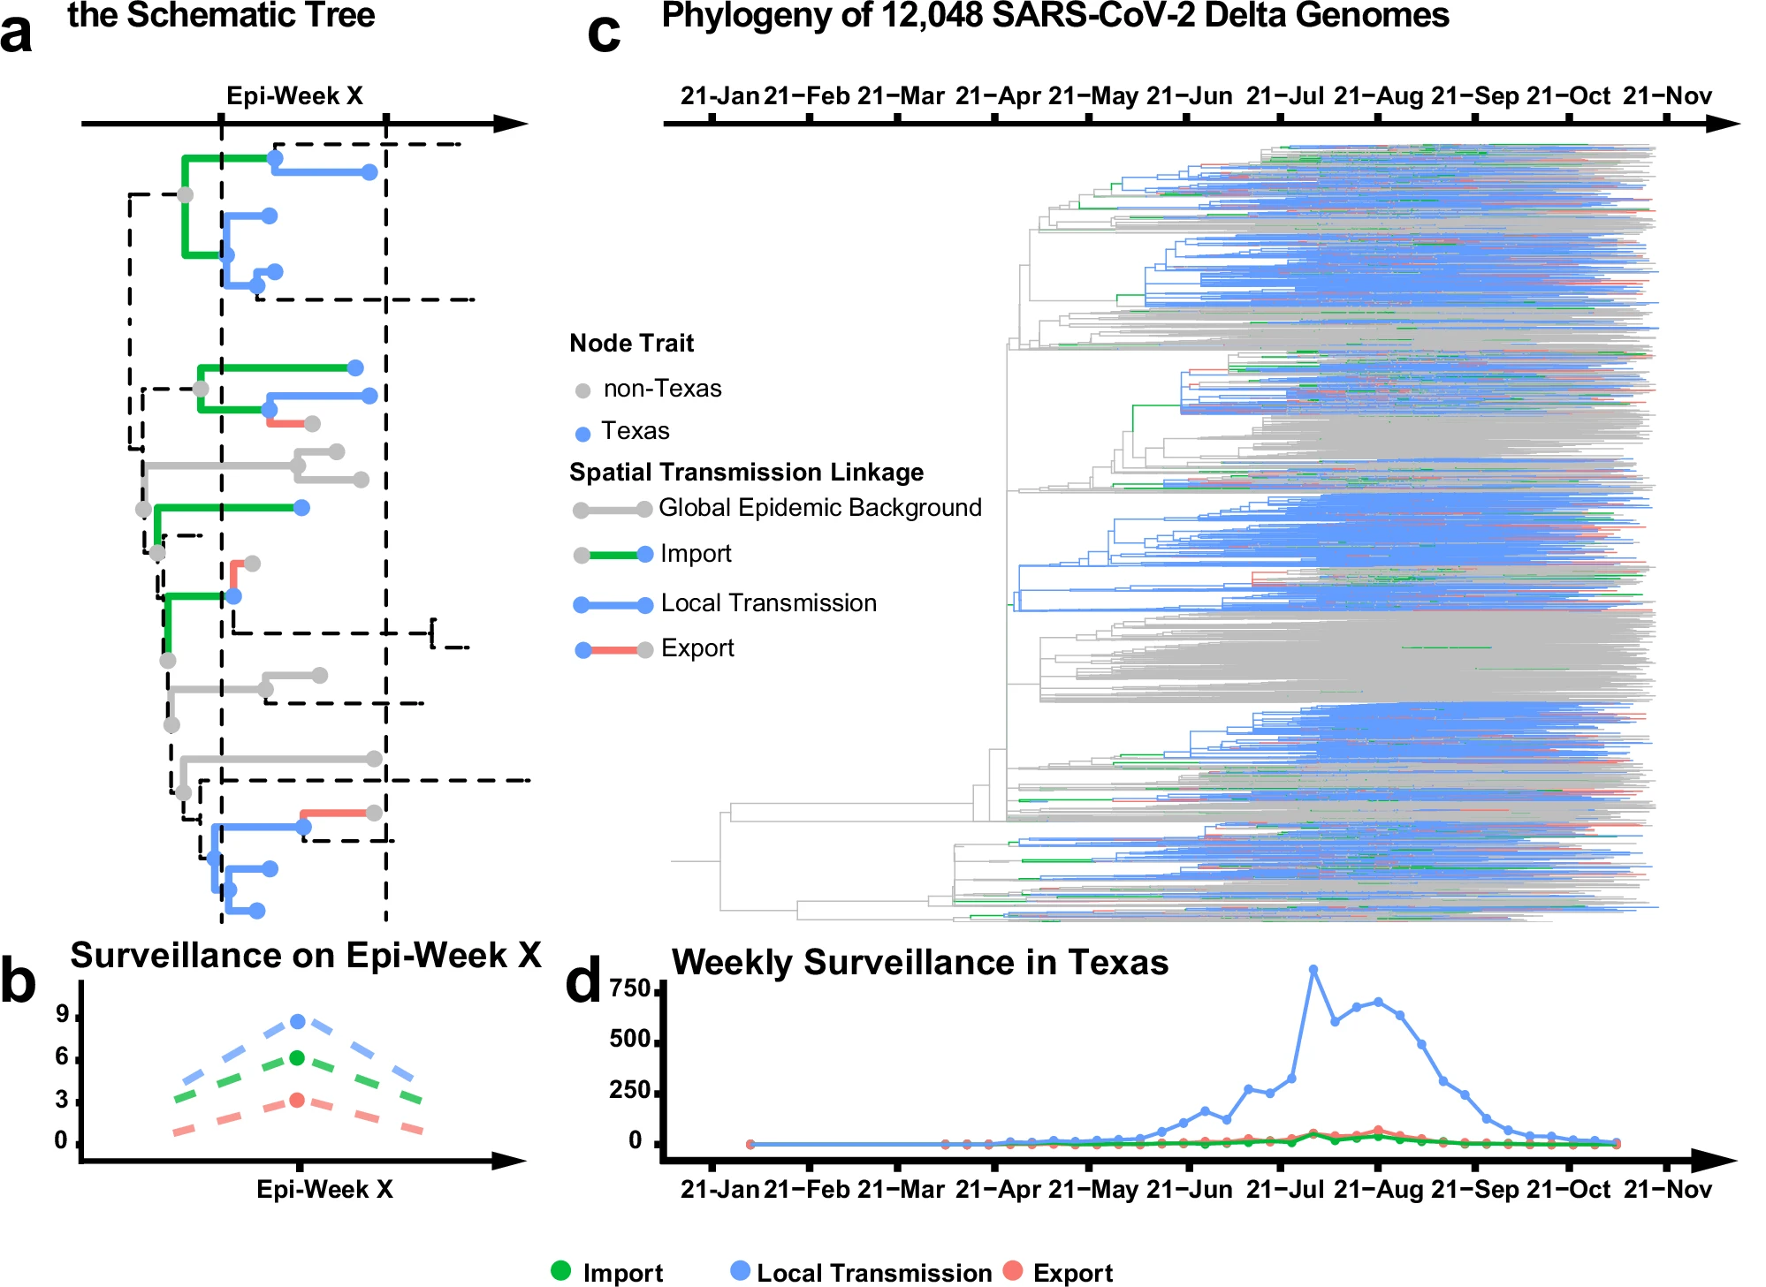

Slide 41
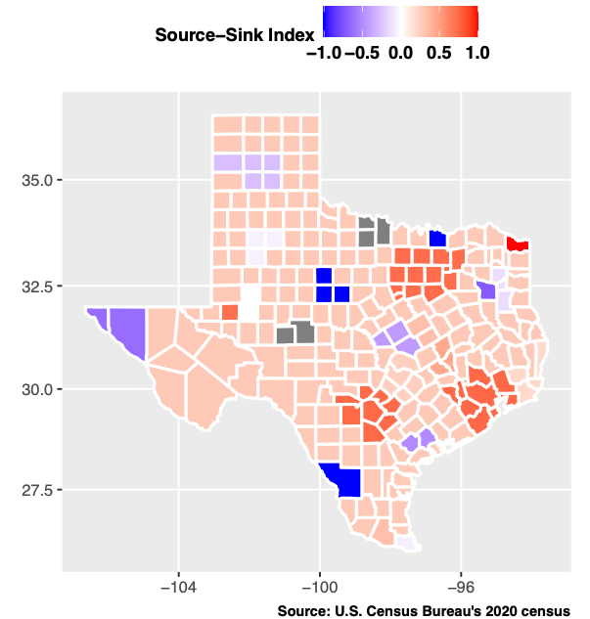
Notes:
Figure 2. Epidemic trends in Houston vs the rural region. The epidemic in Houston was locally maintained, while the epidemic in rural regions heavily relied on introduction.

Slide 42
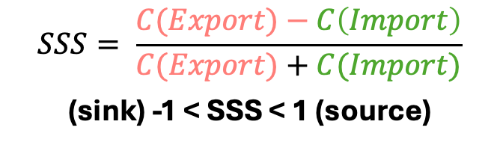
Highly populated urban centers were the major sources of the Delta epidemic in Texas
$$SSS= \frac{C(Export)−C\left(Import\right)}{C(Export)+C(Import)}$$
(sink) -1 < SSS < 1 (source)
Notes:
This conclusion is further supported by the Source-Sink Score (SSS).
We summarized epidemic trends across 25 metropolitan areas and their surrounding rural regions, and then calculated the cumulative SSS for each.
As shown in panel B, RUCC1 areas (densely urbanized) exhibit the highest SSS values.
This shows Highly populated urban centers were the major sources of the Delta epidemic in Texas

Slide 43
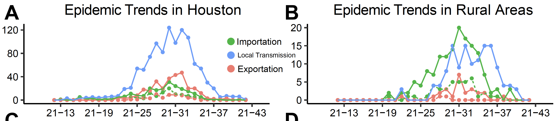
Epidemic in Houston vs Rural Area
Houston – Population of 7122240
The Rural Areas – Population of 3014819
Notes:
What's the difference between the epidemic in urban centers and rural areas?
Using Houston as a representative city, we compared epidemic trends in densely populated urban centers to those in rural areas.
Let’s break it down

Slide 44
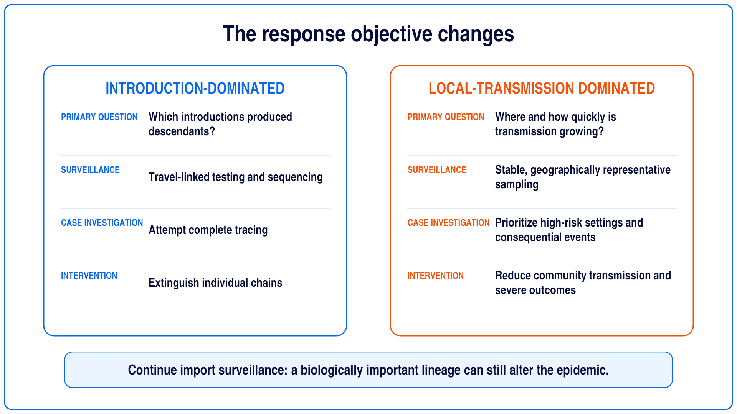

Slide 45
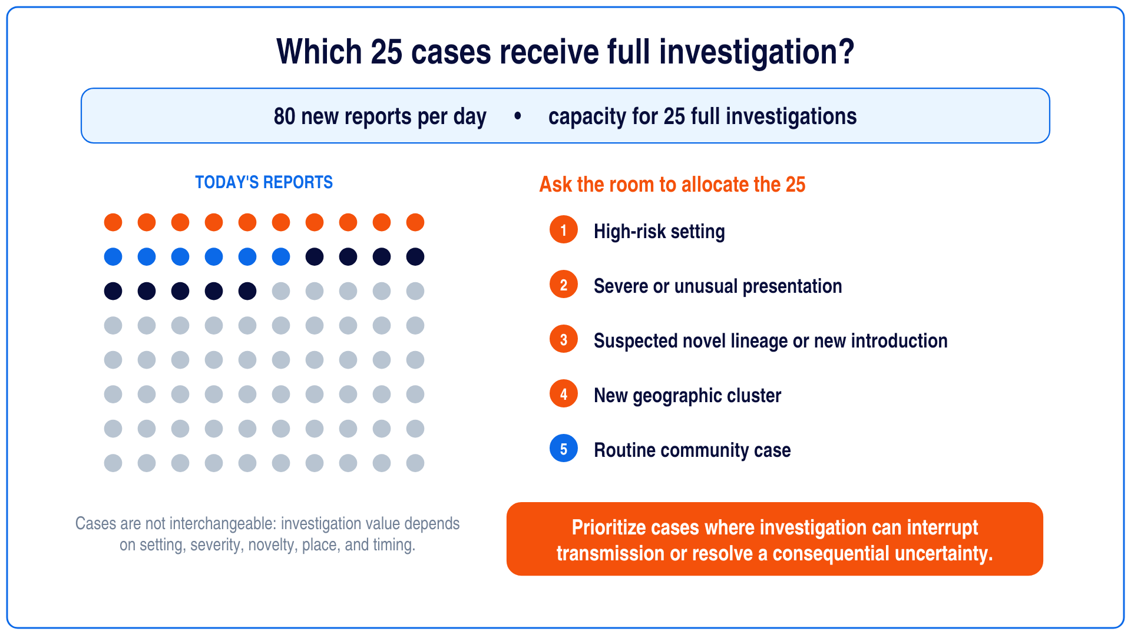
Notes:
Pause for audience allocation before discussing prioritization criteria.

Slide 46
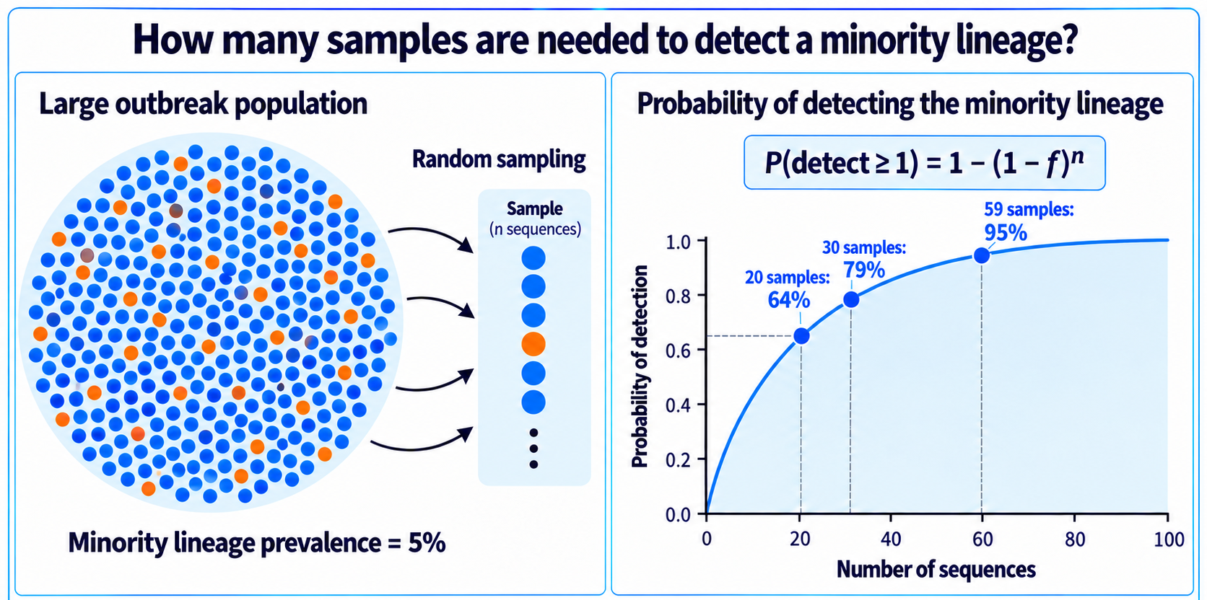
Detection probability is conditional on the sampling frame, allocation, and lineage frequency within the sampled population.

Slide 47
06
Select and evaluate interventions
PUBLIC-HEALTH QUESTION
Where can action interrupt transmission or reduce severe outcomes?
MOLECULAR EPIDEMIOLOGY
Locate expanding networks and monitor change, while recognizing that genomic trajectories do not establish causality.
Operational states overlap across places and populations.

Slide 48
Attributing an intervention effect requires a counterfactual
Region A
Intervention introduced
Region B
No intervention
INTERVENTION
SAME DATE
Lineage growth proxy
Lineage growth proxy
A decline after intervention is an observation. Attribution depends on the comparison population, sampling stability, timing, and competing explanations.
Notes:
The trajectories are hypothetical.
A genomic outcome can contribute to intervention evaluation, but it does not supply the counterfactual or control confounding by itself.

Slide 49
07
Monitor adaptation and changing risk
PUBLIC-HEALTH QUESTION
Has the pathogen changed in a way that alters control?
MOLECULAR EPIDEMIOLOGY
Detect genetic change and prioritize variants for epidemiologic, antigenic, and experimental evaluation.
Operational states overlap across places and populations.

Slide 50
Variant frequency, phenotype, and public-health risk are separate inferences
OBSERVATION
1
Check sampling, geography, founder effects, and denominators
Lineage frequency increases
BIOLOGICAL INFERENCE
2
Estimate growth advantage and test plausible mechanisms
A phenotype may explain growth
RESPONSE INFERENCE
3
Evaluate severity, immunity, diagnostics, treatment, and intervention value
The change may alter control
Increasing frequency initiates an investigation. It does not complete one.
Notes:
A growing lineage can reflect biological advantage, introductions, superspreading, sampling, or chance.
Keep genetic, phenotypic, and decision-level claims separate.

Slide 51
Molecular epidemiology supports different decisions
RESPONSE STATE
GENOMIC QUESTION
DECISION
Preparedness
Define expected diversity
Recognize meaningful departures
Anomaly
Verify identity and novelty
Escalate or contain the investigation
Establishment
Introductions or local spread?
Rebalance individual containment and population-level control while maintaining import surveillance.
Clusters
Which links remain plausible?
Set investigation boundaries
Expansion
What drives incidence?
Allocate surveillance and control capacity
Intervention
Where does transmission change?
Target action and evaluate outcomes
Adaptation and learning
Has risk changed? What was missed?
Revise control and preparedness
The value of genomic data depends on the epidemic process, surveillance system, and decision.
Notes:
Return to the repeated decision frame: problem, evidence, genomic contribution, decision consequence, and failure mode.

